Slide 1
Stations of the Cross
Jubilee Year of Mercy
The Cross of Christ contains all the Love of God, his immeasurable Mercy.
Pope Francis, July 2013

Slide 2
In the name of the Father, and of the Son,
and of the Holy Spirit.
Amen.
May the grace of God,
So rich in mercy and boundless in compassion,
be with your all.
And with your spirit.

Slide 3
I
We adore you, O Christ, and praise you.
Because by your holy cross You have redeemed the world.

Slide 4
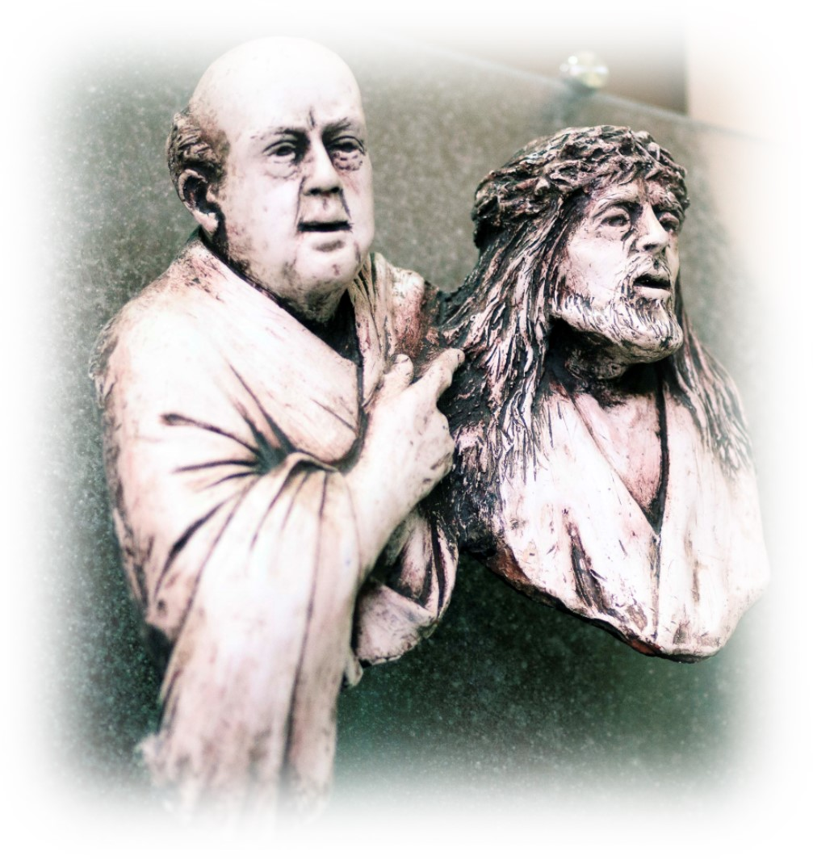
I
Jesus
before
Pilate
© Catholic Archbishop of Perth

Slide 5
‘Are you the king of the Jews?’
John 18: 28,33
Jesus’ response to Pilate’s question is not to condemn,
but an invitation to reflect on God’s love and mercy.

Slide 6
Great is God’s Mercy
© hidesy / Shutterstock.com

Slide 7
II
We adore you, O Christ, and praise you.
Because by your holy cross You have redeemed the world.

Slide 8
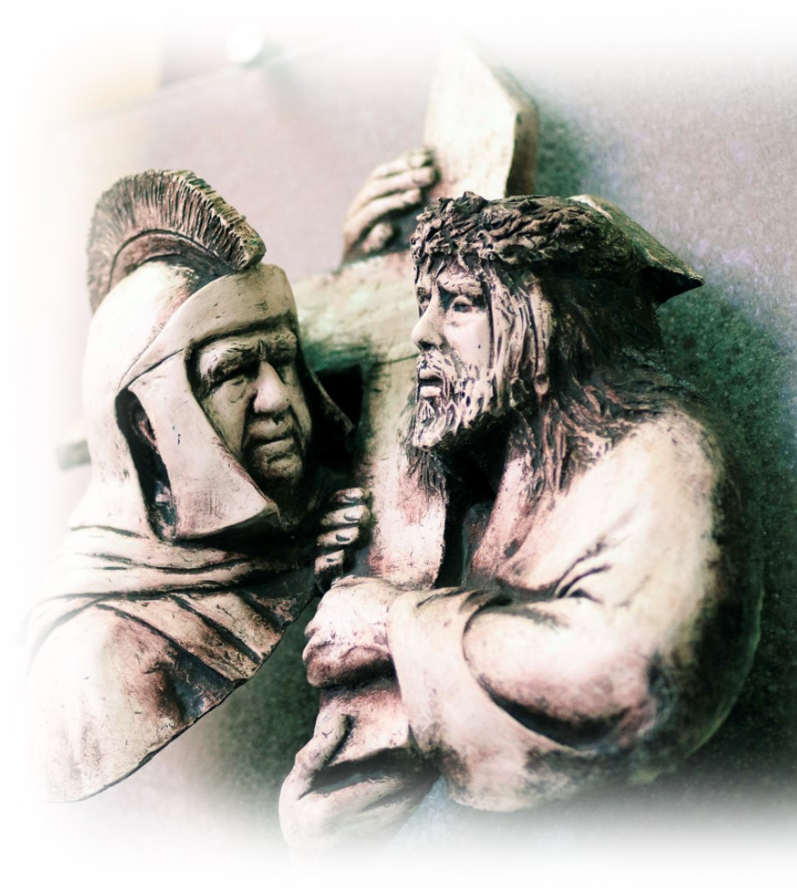
II
Jesus
Carries His Cross
© Catholic Archbishop of Perth

Slide 9
‘… but if you lose your life for my sake, you will save it.’ Luke 9: 22-24
Christ walks with us, helping to lighten our burdens. But he extends an invitation to be sensitive to the pain and needs
of others.

Slide 10
Jesus unites Himself
to the Silence of Victims
© Catholic Archbishop of Perth

Slide 11
III
We adore you, O Christ, and praise you.
Because by your holy cross You have redeemed the world.

Slide 12
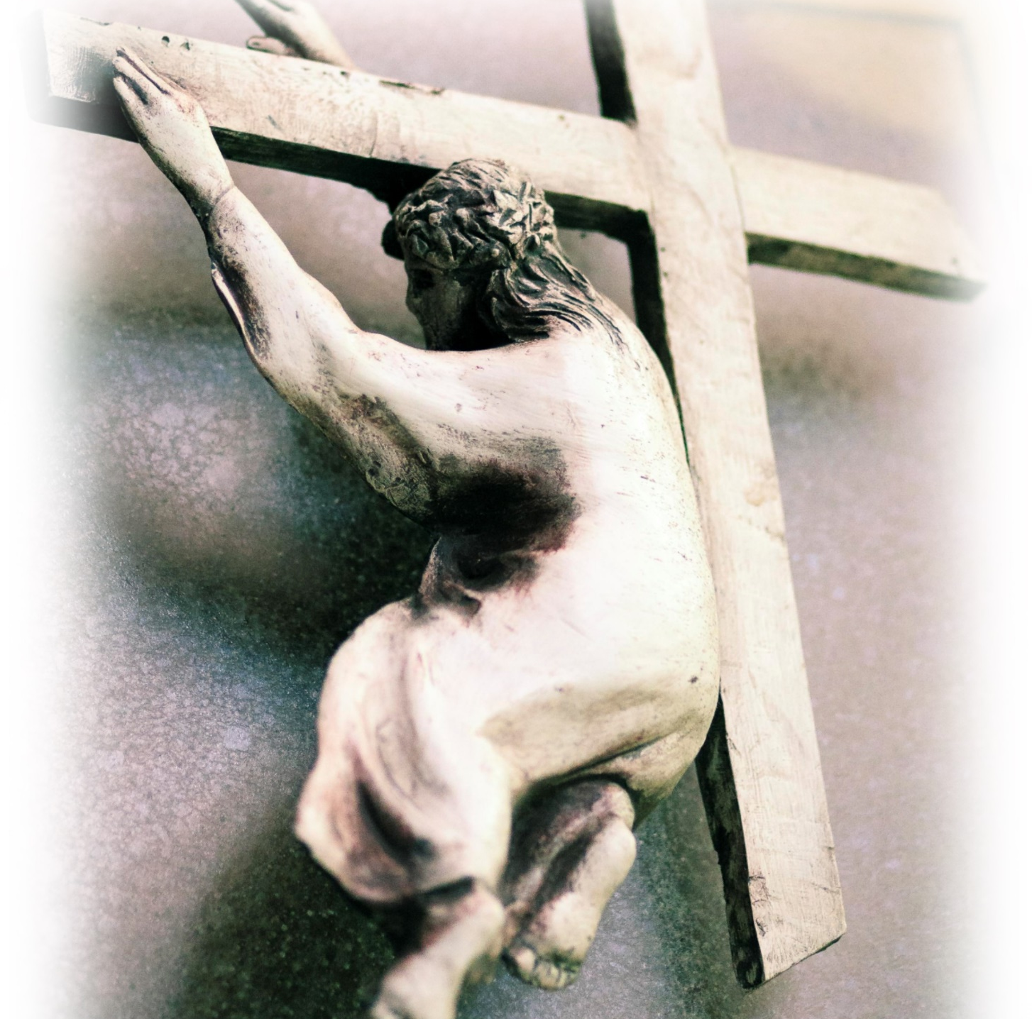
III
Jesus
Falls for the First Time
© Catholic Archbishop of Perth

Slide 13
‘… the load I put on you is light.’ Matthew 11: 28-30
In those moments of struggle in our life, may we draw strength from Jesus 'sufferings.
As Christians we do not pretend that life is all beauty, but we profess that Jesus passed through death to glory.

Slide 14
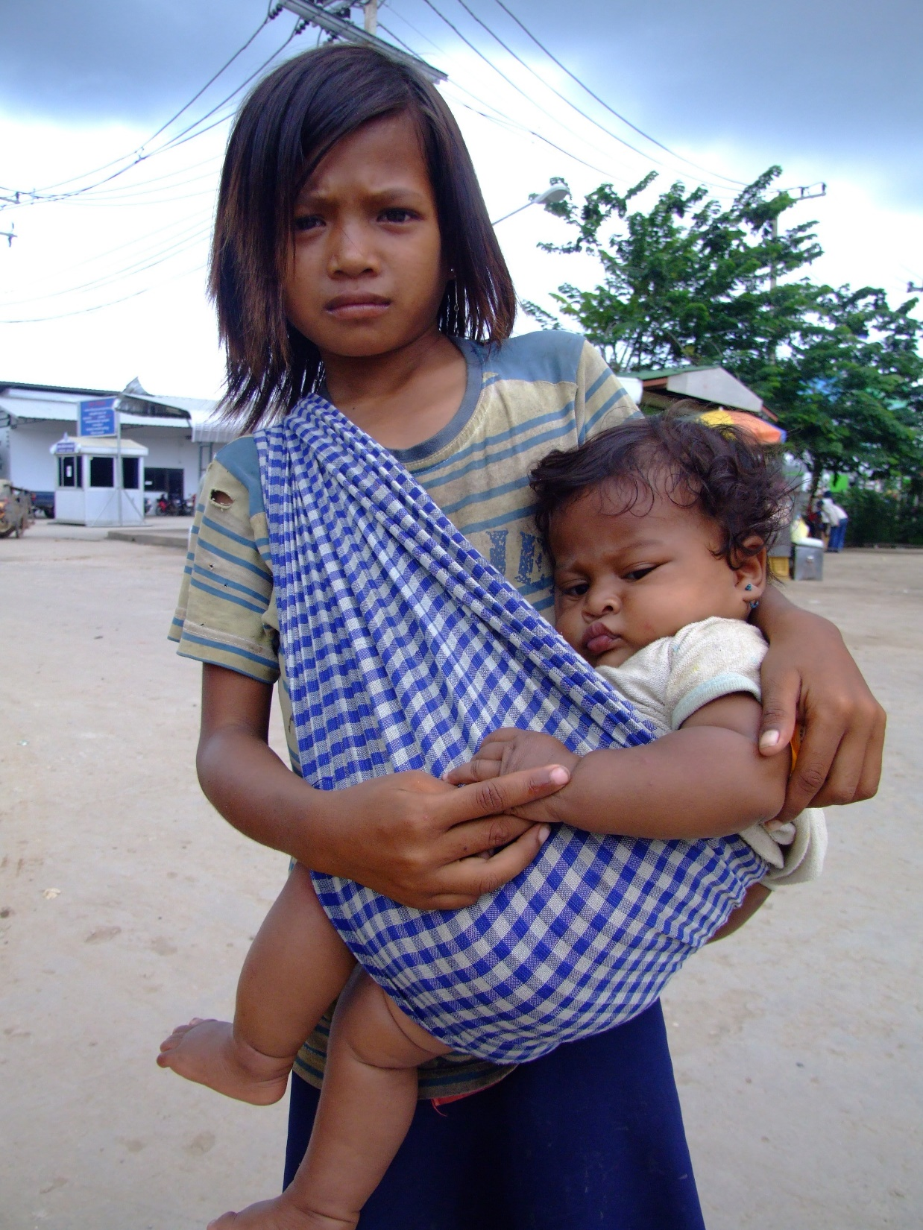
We live in the Light of His Paschal Mystery
© Charlie Edward / Shutterstock.com

Slide 15
IV
We adore you, O Christ, and praise you.
Because by your holy cross You have redeemed the world.

Slide 16
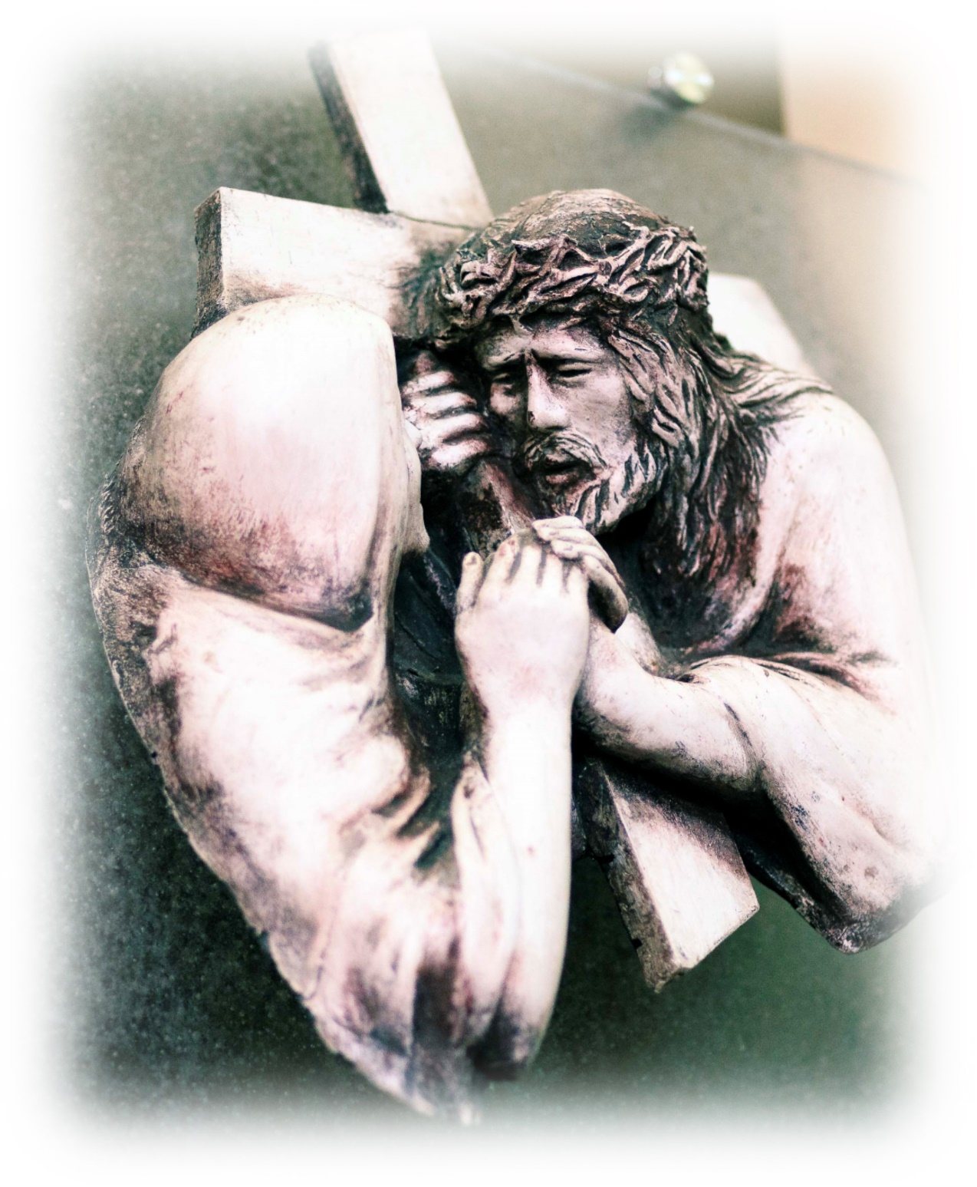
IV
Jesus
Meets His Mother
© Catholic Archbishop of Perth

Slide 17
‘This child is chosen by God…’ Luke 2: 34-35
Mary’s heart also suffered the agony of her Son’s crucifixion. As we experience sharp sword’s in life, may we draw strength from our heavenly Mother who is always there to intercede for us.

Slide 18
Christ Sacrificed His Flesh, Mary Her Soul
© itsmejust/ Shutterstock.com

Slide 19
V
We adore you, O Christ, and praise you.
Because by your holy cross You have redeemed the world.

Slide 20
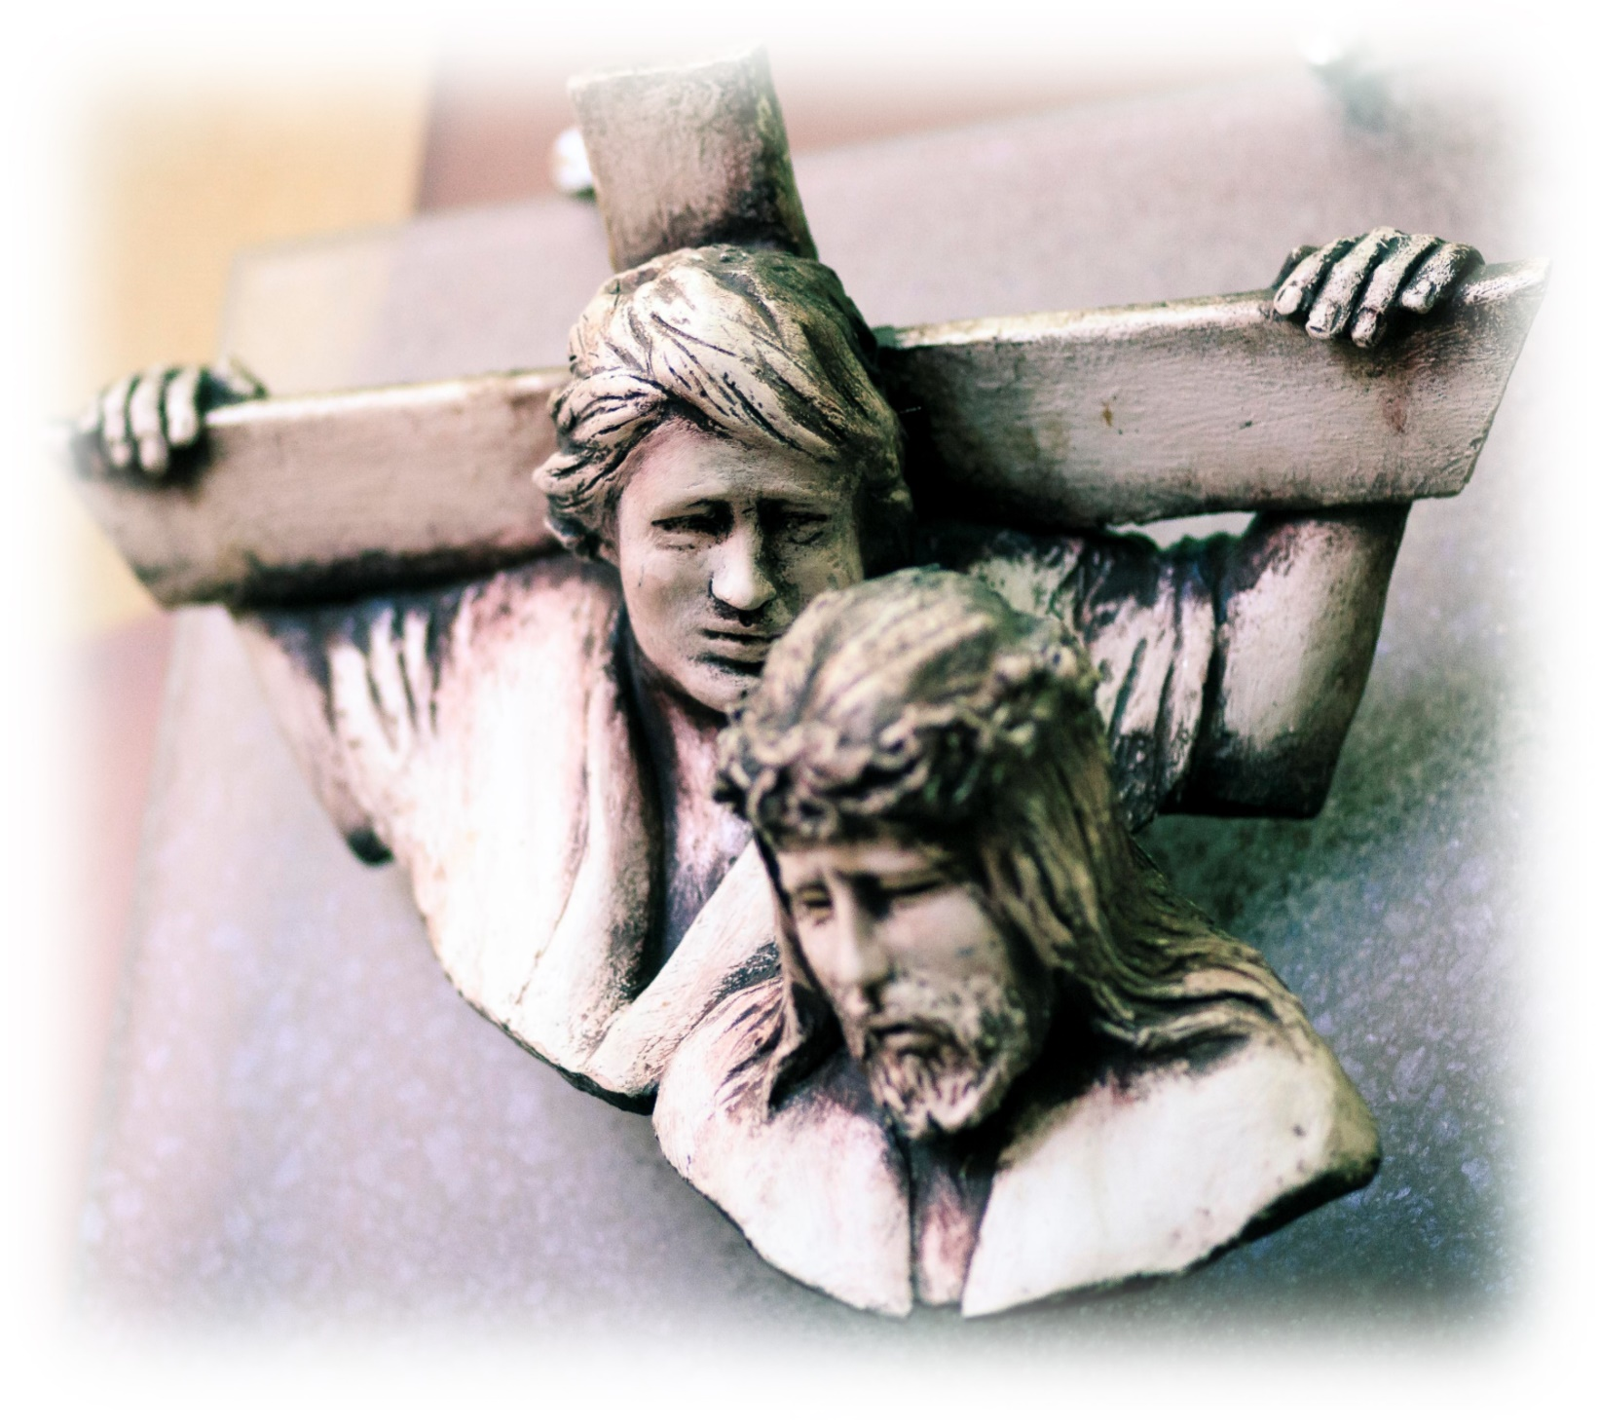
V
Jesus is Helped by Simon
© Catholic Archbishop of Perth

Slide 21
‘… the soldiers forced him to carry Jesus’ cross.’
Mark 15: 21-22
A small step in the midst of great limitations is what is pleasing to the God of Mercy.

Slide 22
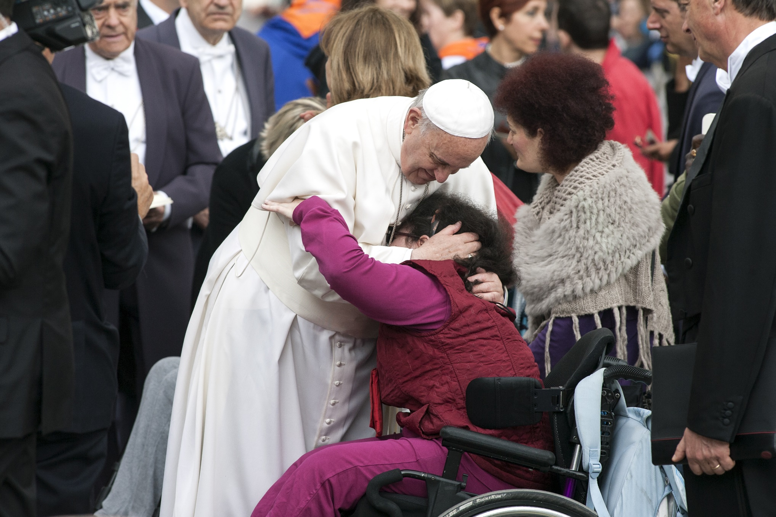
Touched by God’s Saving Love
© Guilio Napolitano/ Shutterstock.com

Slide 23
VI
We adore you, O Christ, and praise you.
Because by your holy cross You have redeemed the world.

Slide 24
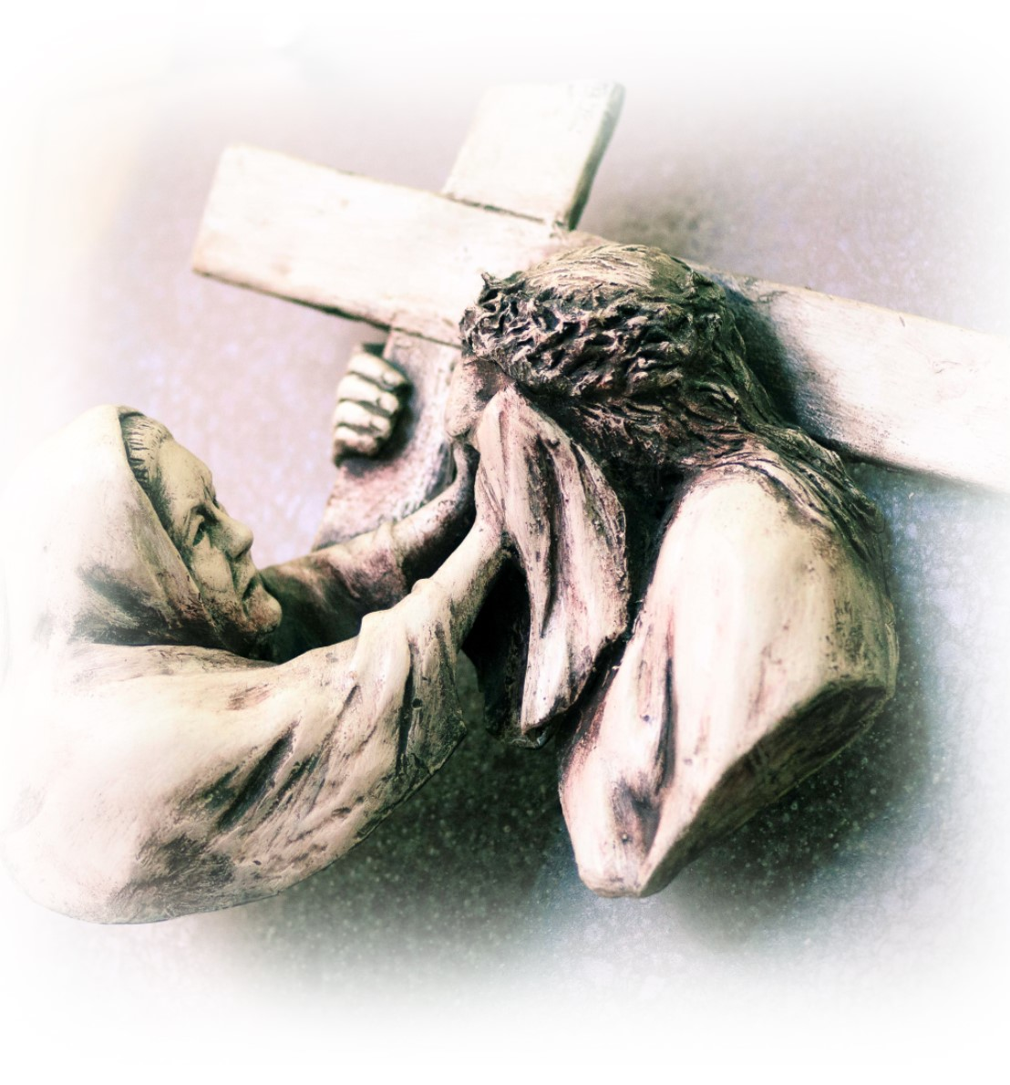
VI
Veronica Wipes Jesus’ Face
© Catholic Archbishop of Perth

Slide 25
‘What I know now is only partial; then it will be complete as God’s knowledge of me.’
1Cor 13: 12-13
On our pilgrim journey, home to the face of God’s mercy, may we reflect the face of the merciful Father to all those travelling with us.

Slide 26
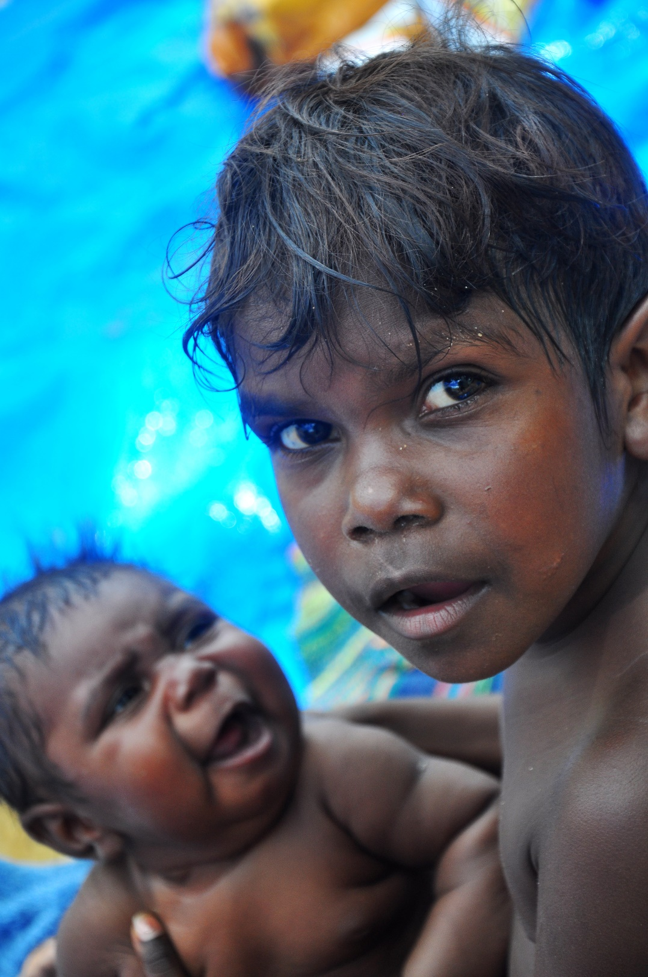
The Face
of
God Reflected
in
Many
Faces
© Calvin Au/ Shutterstock.com

Slide 27
VII
We adore you, O Christ, and praise you.
Because by your holy cross You have redeemed the world.

Slide 28
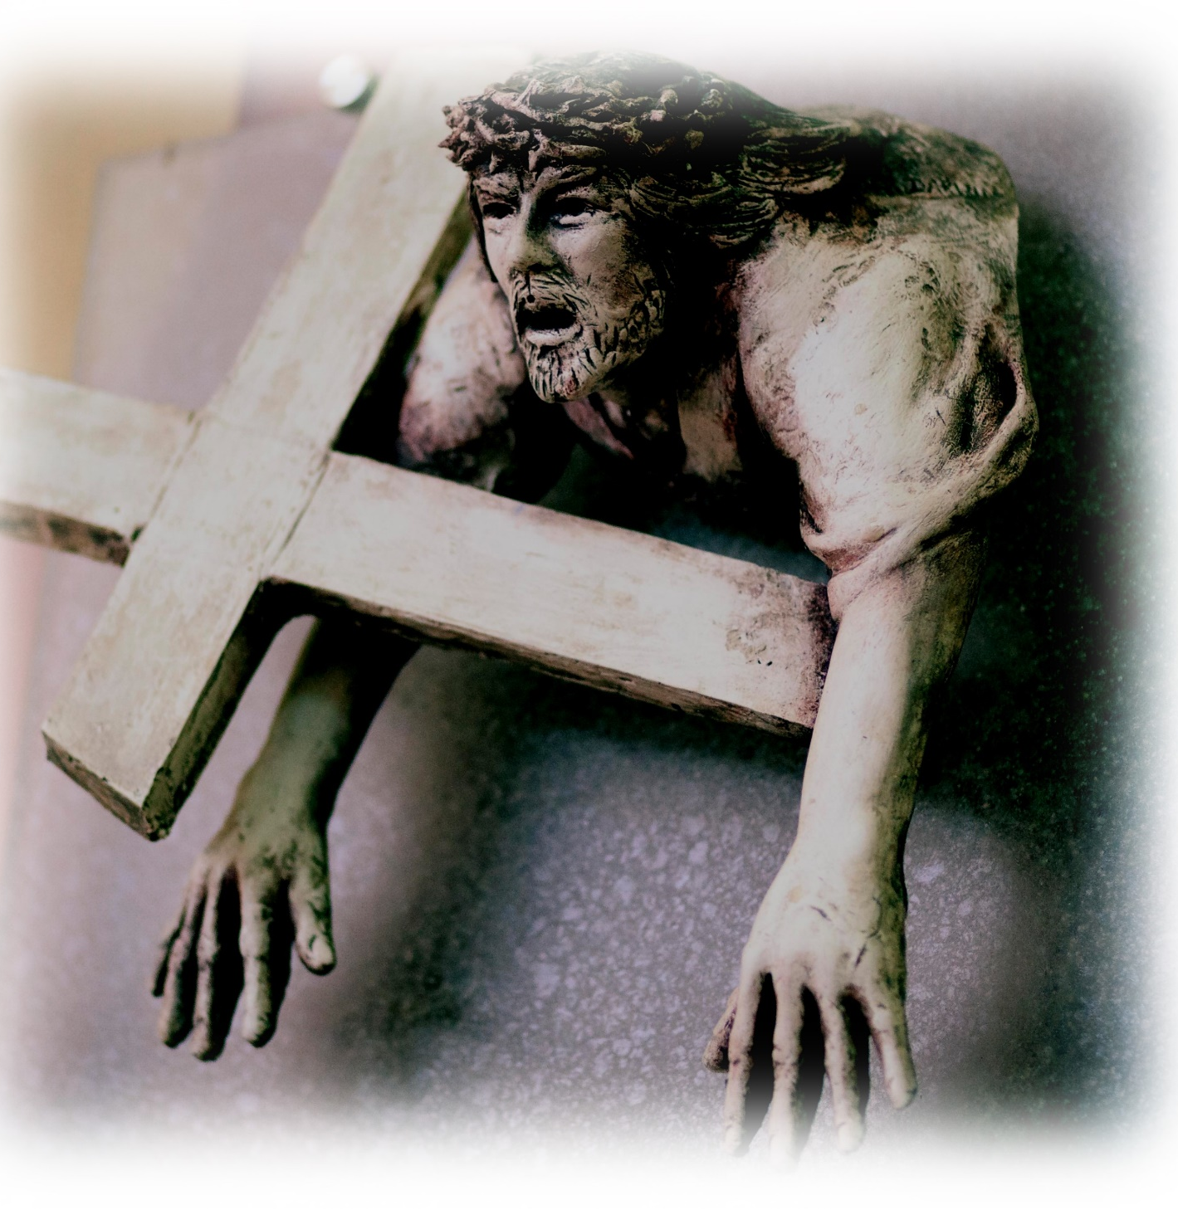
VII
Jesus Falls
a
Second Time
© Catholic Archbishop of Perth

Slide 29
‘Our High Priest is not one who cannot feel sympathy for our weakness.’
Hebrews 4: 15-16
Let us call on Christ’s mercy as we experience shadows in our life and look forward with courage to the light and comfort of God’s grace.

Slide 30
Christ’s Cross,
embraced with Love
© Zoltan Major/ Shutterstock.com

Slide 31
VIII
We adore you, O Christ, and praise you.
Because by your holy cross You have redeemed the world.

Slide 32
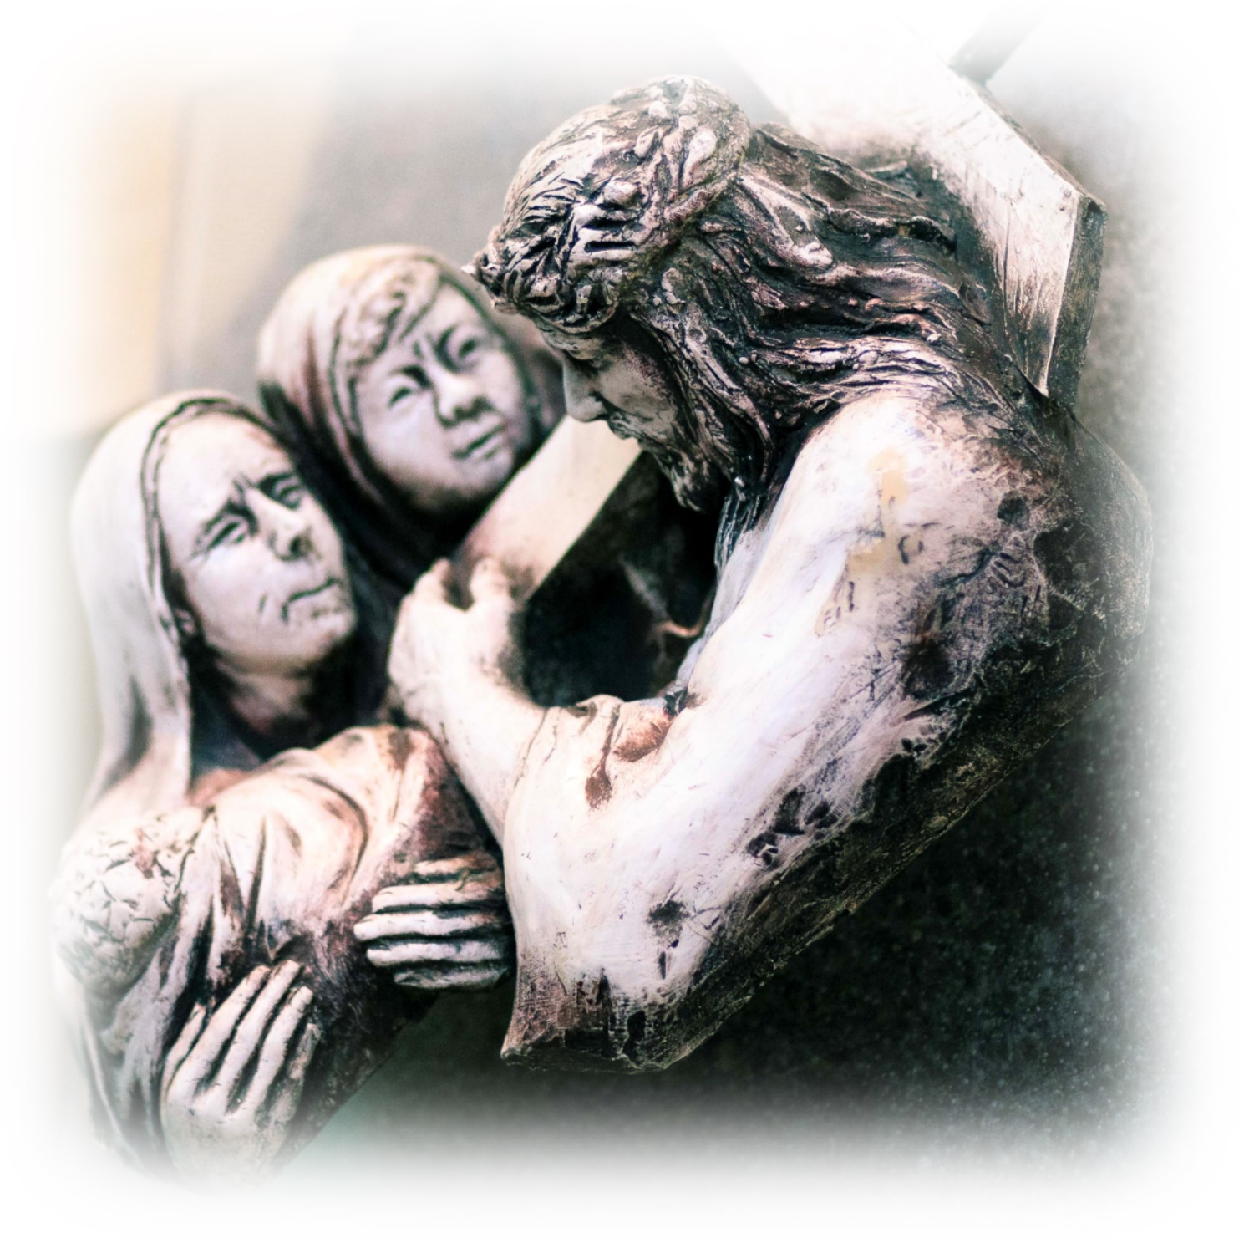
VIII
Jesus Speaks to the Women
© Catholic Archbishop of Perth

Slide 33
‘Don’t cry for me, but for yourselves and your children.’
Luke 23: 27-31
Let us show the tender face of God’s mercy by the way we welcome all we meet.

Slide 34
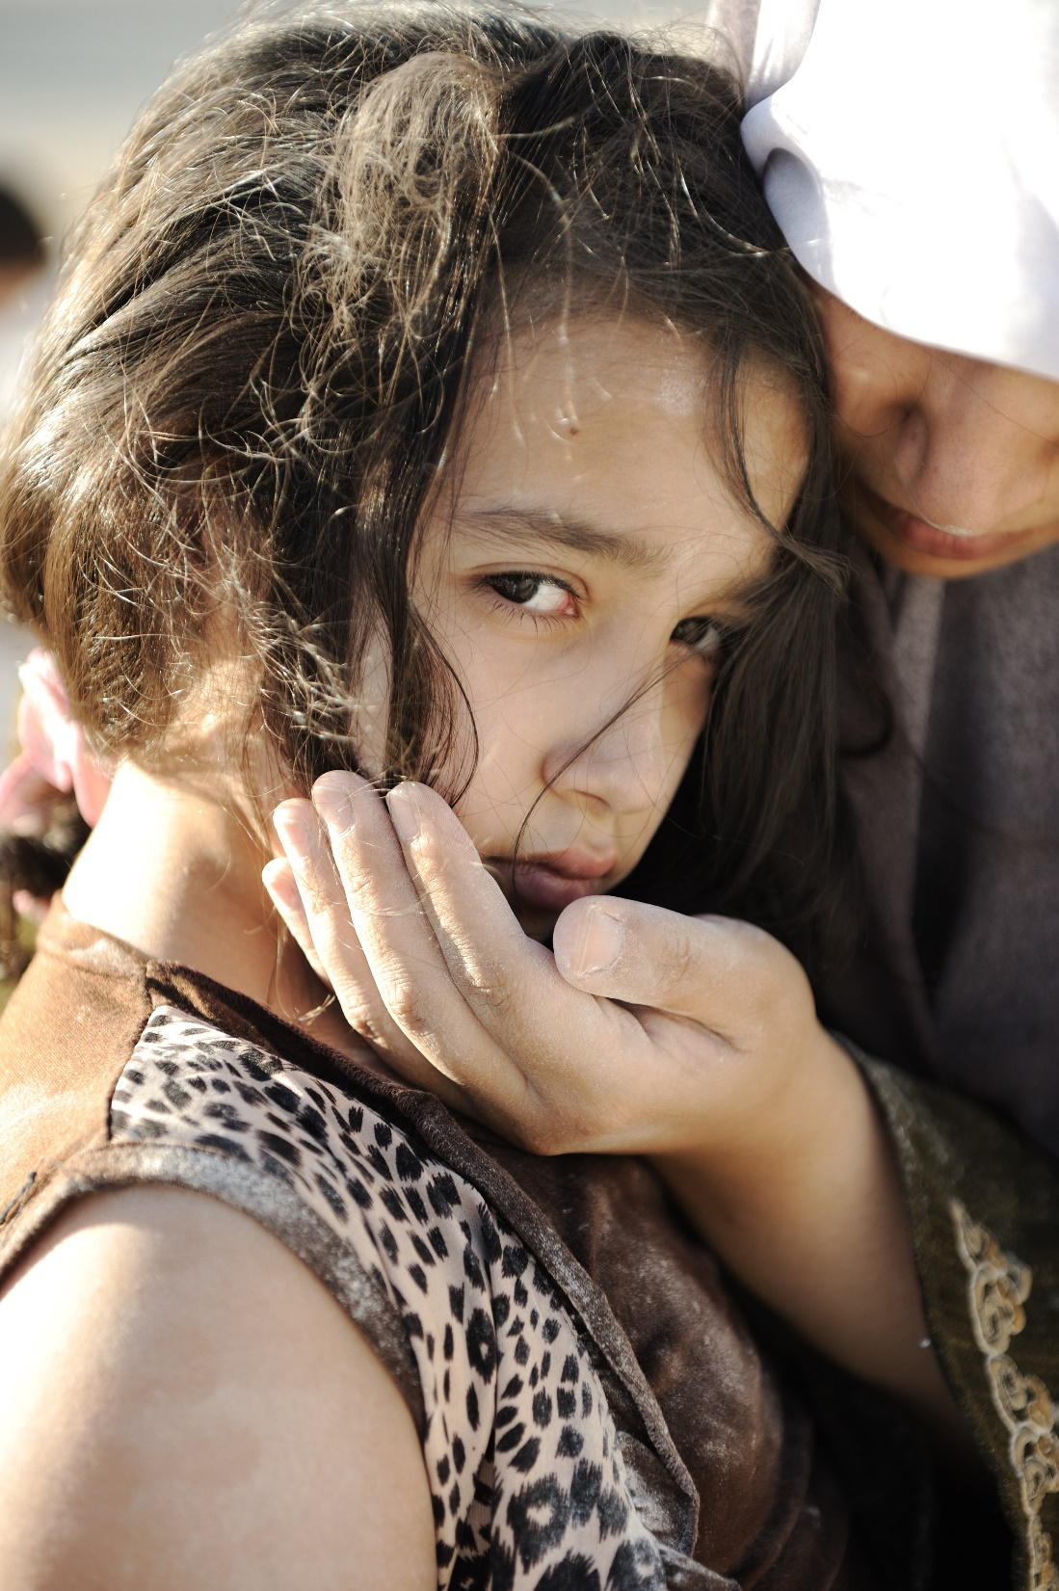
Show the Tender Face of God
His Mercy
© ZouZou/ Shutterstock.com

Slide 35
IX
We adore you, O Christ, and praise you.
Because by your holy cross You have redeemed the world.

Slide 36
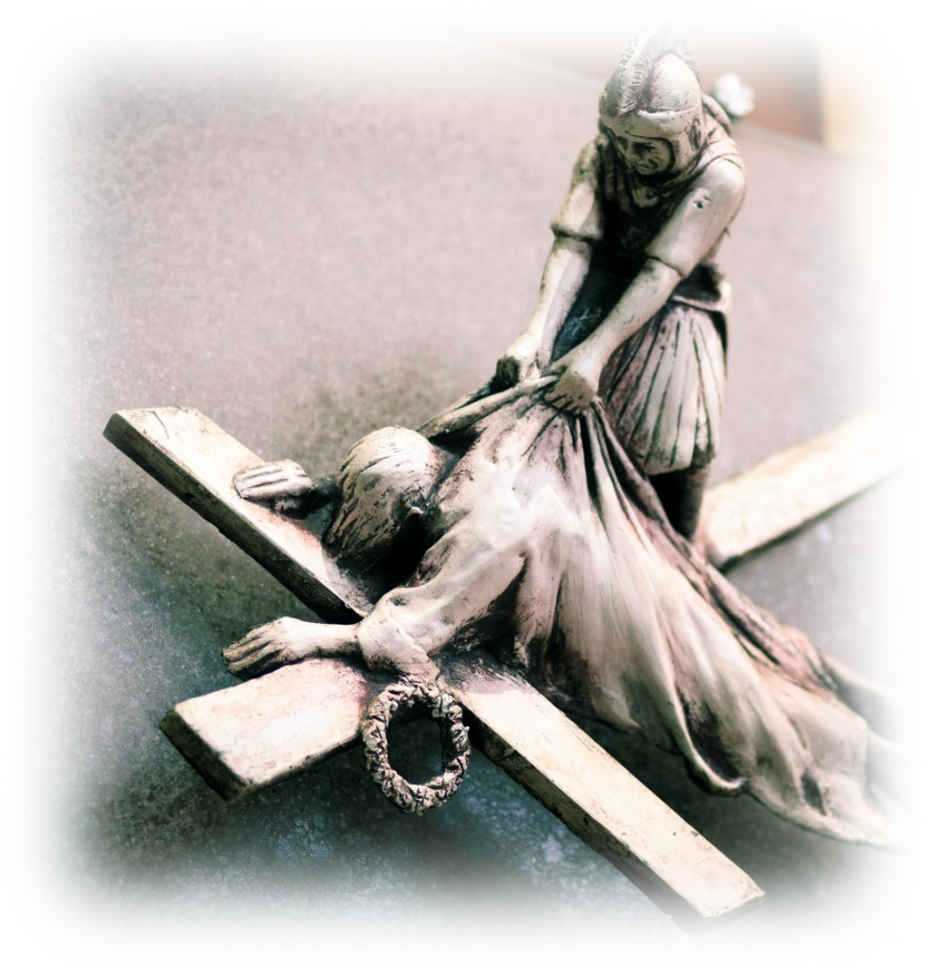
IX
Jesus Falls a
Third Time
© Catholic Archbishop of Perth

Slide 37
‘Many will give up their faith … hold out to the end and be saved.’
Matthew 24: 10-13
Those who believe,
are transformed by the love and mercy to which they open their hearts of faith.

Slide 38
Those Who Believe are Transformed
© wk1003mike/ Shutterstock.com

Slide 39
X
We adore you, O Christ, and praise you.
Because by your holy cross You have redeemed the world.

Slide 40
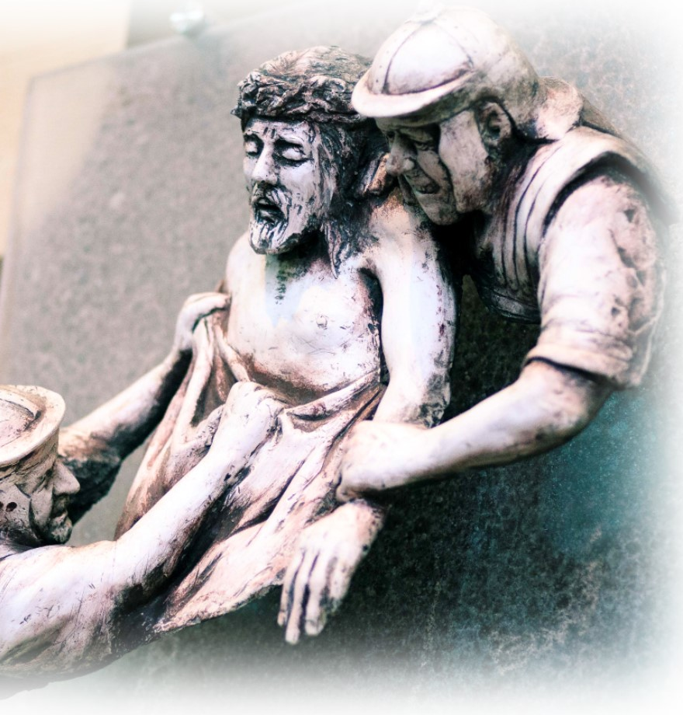
X
Jesus
is Stripped
© Catholic Archbishop of Perth

Slide 41
‘They … divided his clothes among them by throwing dice.’ Matthew 27: 35-40
Through Baptism, each of us build the Body of Christ; through mercy we propagate Christ’s love in a world of urgent need. Have the courage to go against the culture efficiency and waste. Welcome everyone and clothe them in God’s love and mercy.

Slide 42
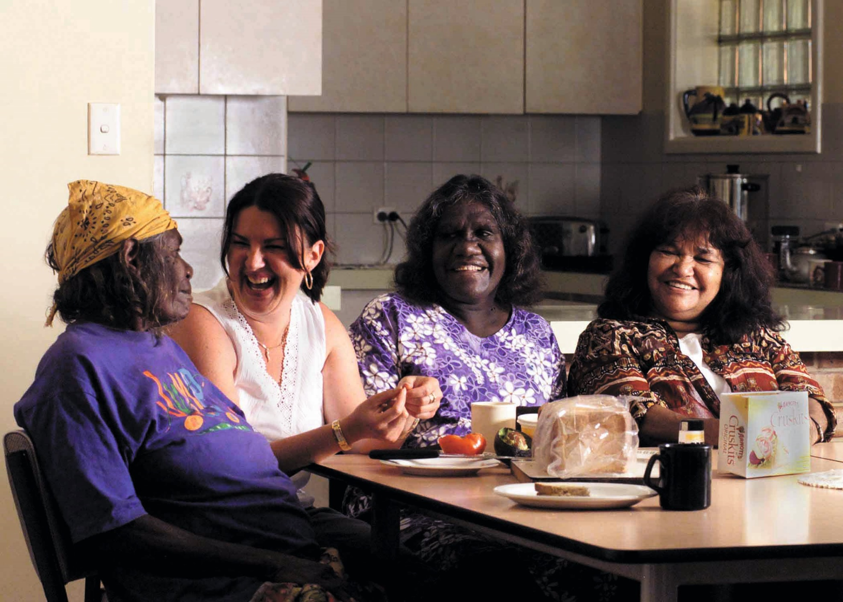
Solidarity and Fraternity
©Catholic Archbishop of Perth

Slide 43
XI
We adore you, O Christ, and praise you.
Because by your holy cross You have redeemed the world.

Slide 44
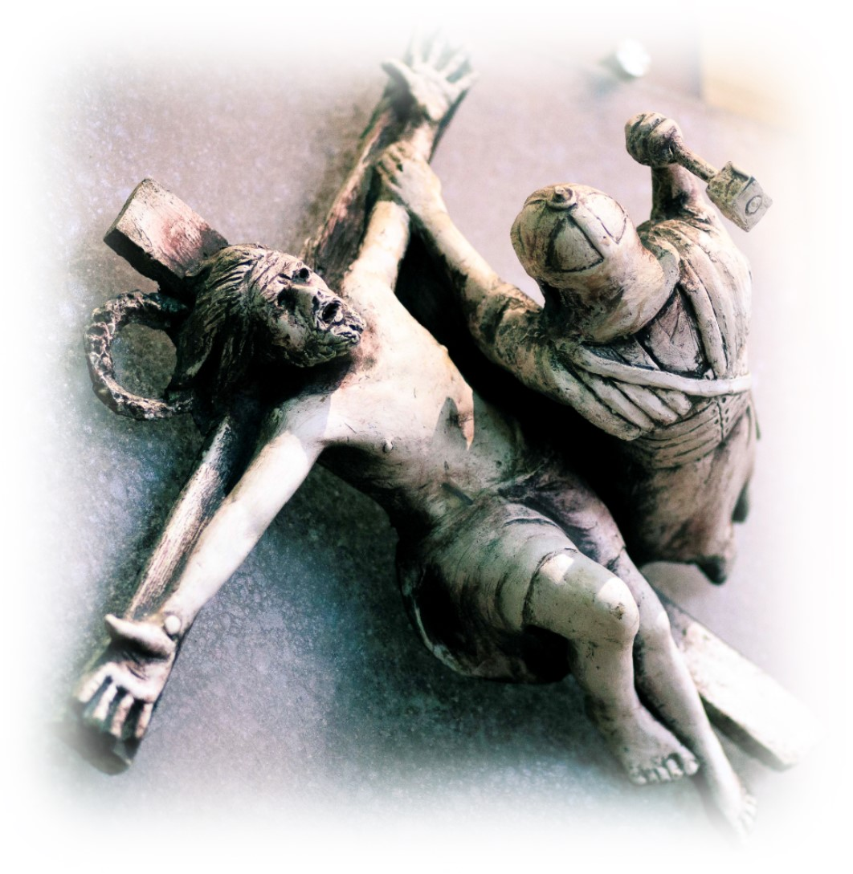
XI
Jesus is Nailed to the Cross
© Catholic Archbishop of Perth

Slide 45
‘… the king of the Jews.’ Matthew 27: 27-30
Have courage!
You do not carry the cross of Christ alone.
I carry it with you.

Slide 46
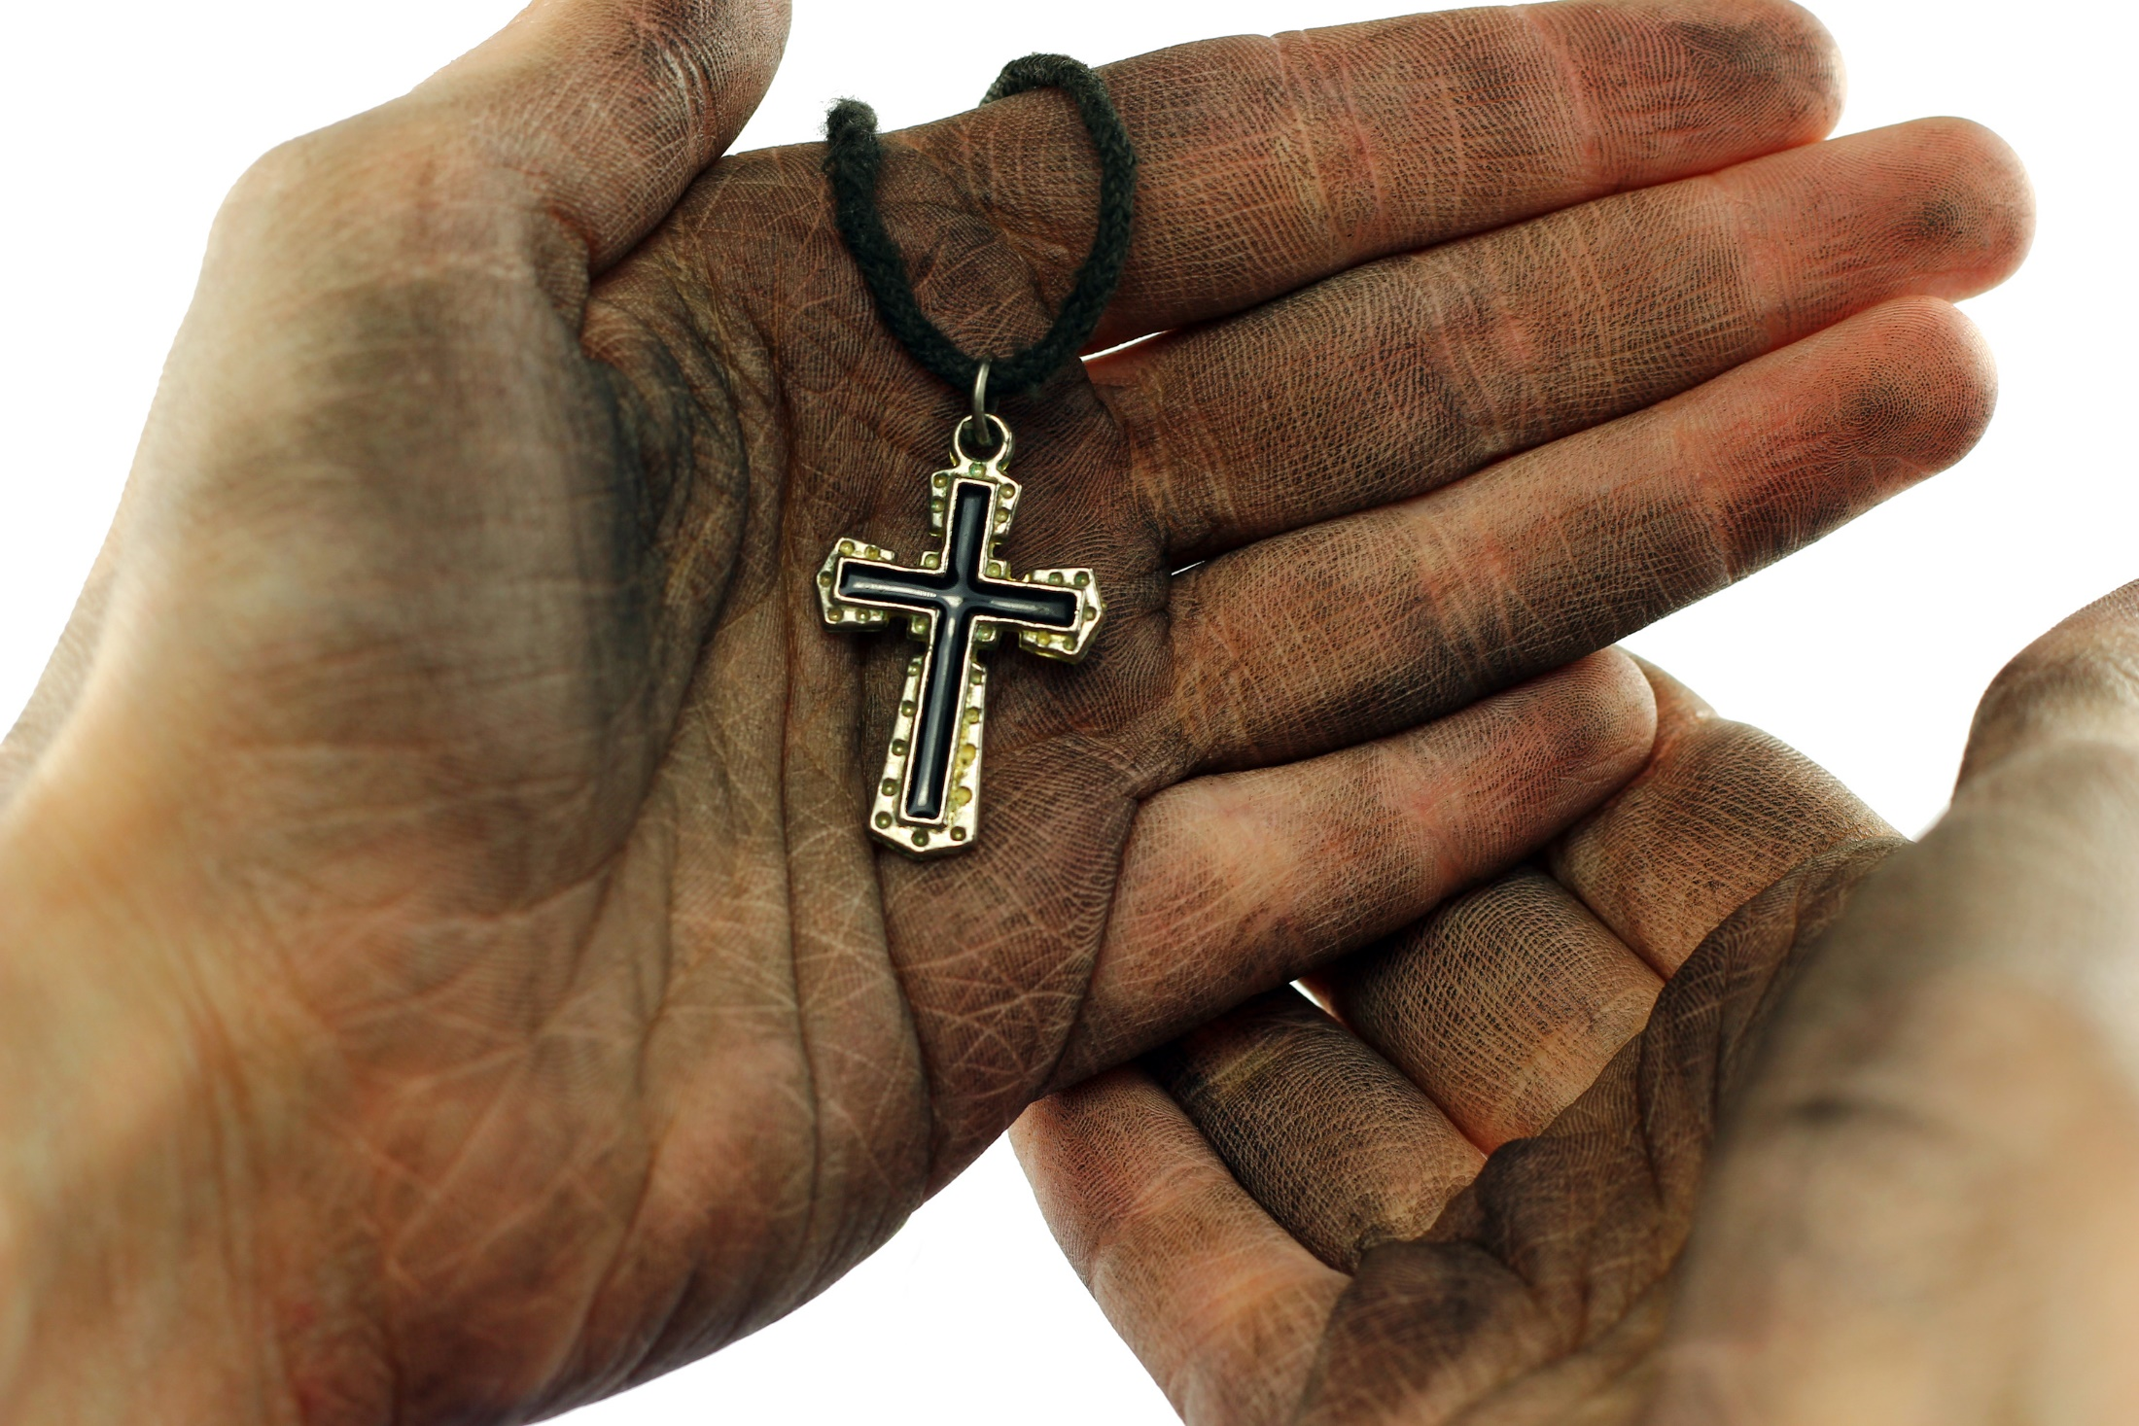
United with Those Who are Persecuted
©Cristina Negoita / Shutterstock.com

Slide 47
XII
We adore you, O Christ, and praise you.
Because by your holy cross You have redeemed the world.

Slide 48
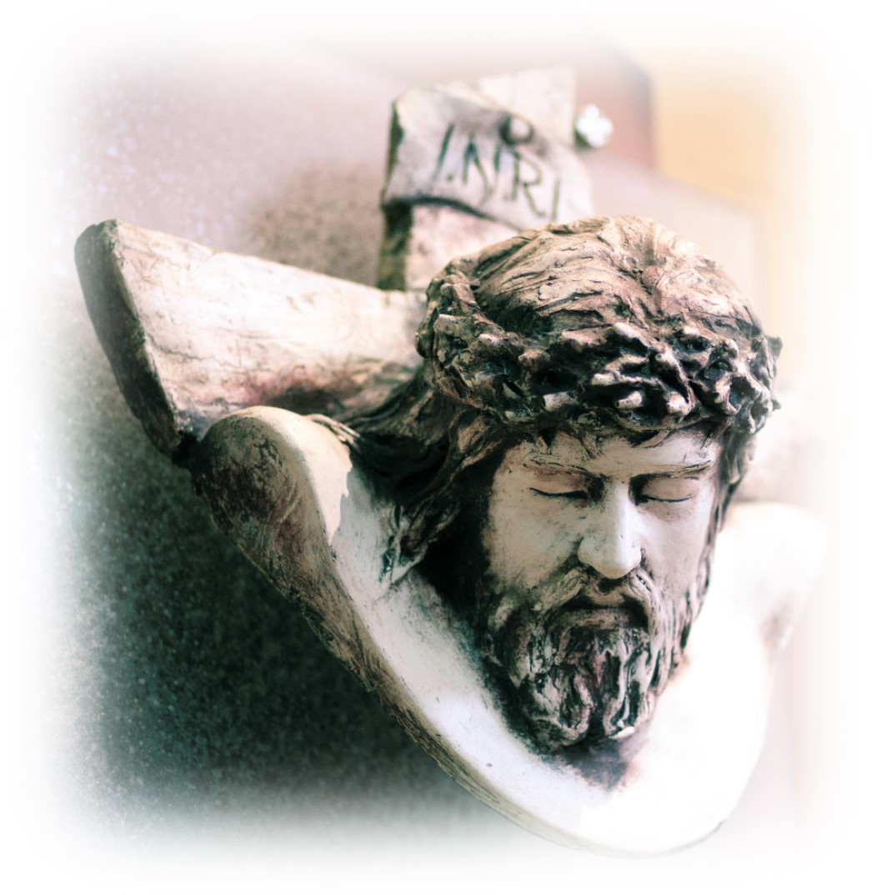
XII
Jesus Dies on the Cross
© Catholic Archbishop of Perth

Slide 49
‘Jesus cried out with a loud shout’ Mark 15: 33-36
In our cry for help in the Father’s mercy, let us also shout out our joy!

Slide 50
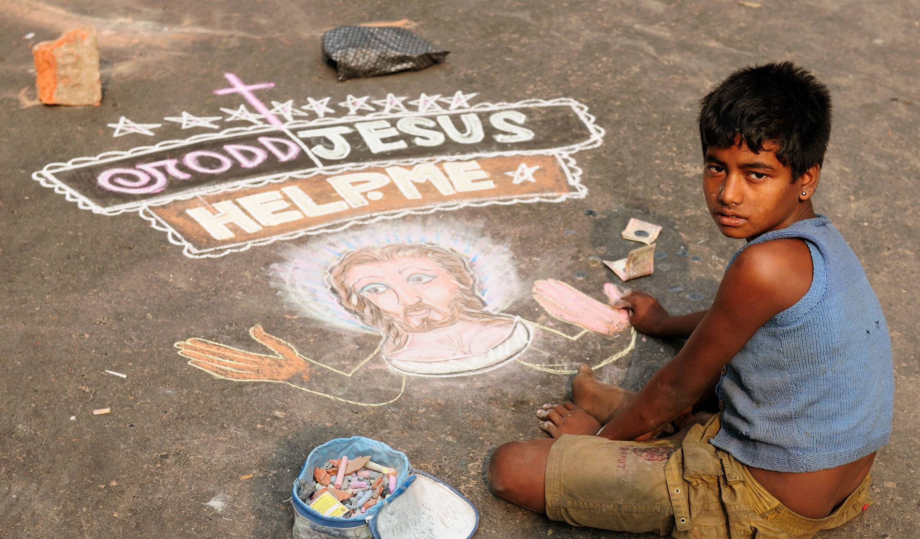
Bring to Christ’s Cross our Joys,
our Sufferings and our Failures
©Rafal Cichawa/ Shutterstock.com

Slide 51
XIII
We adore you, O Christ, and praise you.
Because by your holy cross You have redeemed the world.

Slide 52
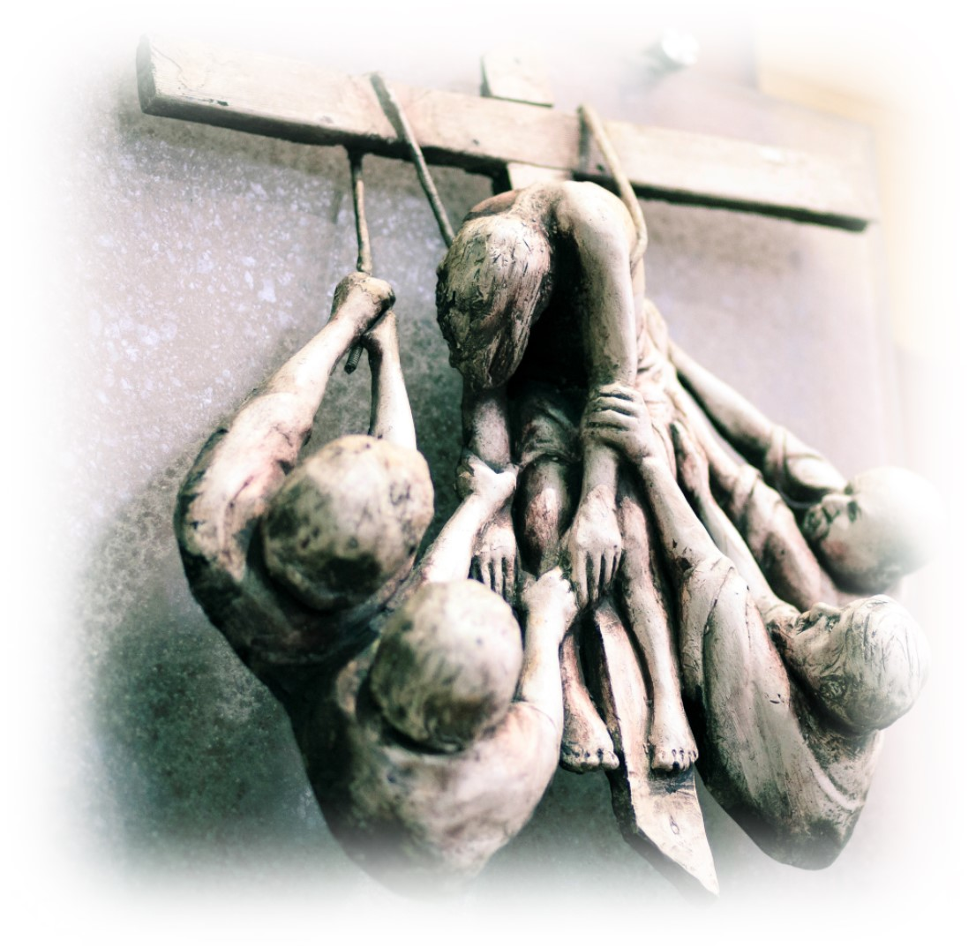
XIII
Jesus is Taken Down from the Cross
© Catholic Archbishop of Perth

Slide 53
‘Two men took Jesus’ body and wrapped it in linen cloths …’ John 19: 40-42
As sisters and brothers of Christ, called to clothe others with dignity,
compassion and love.
This is how we live Mercy.

Slide 54
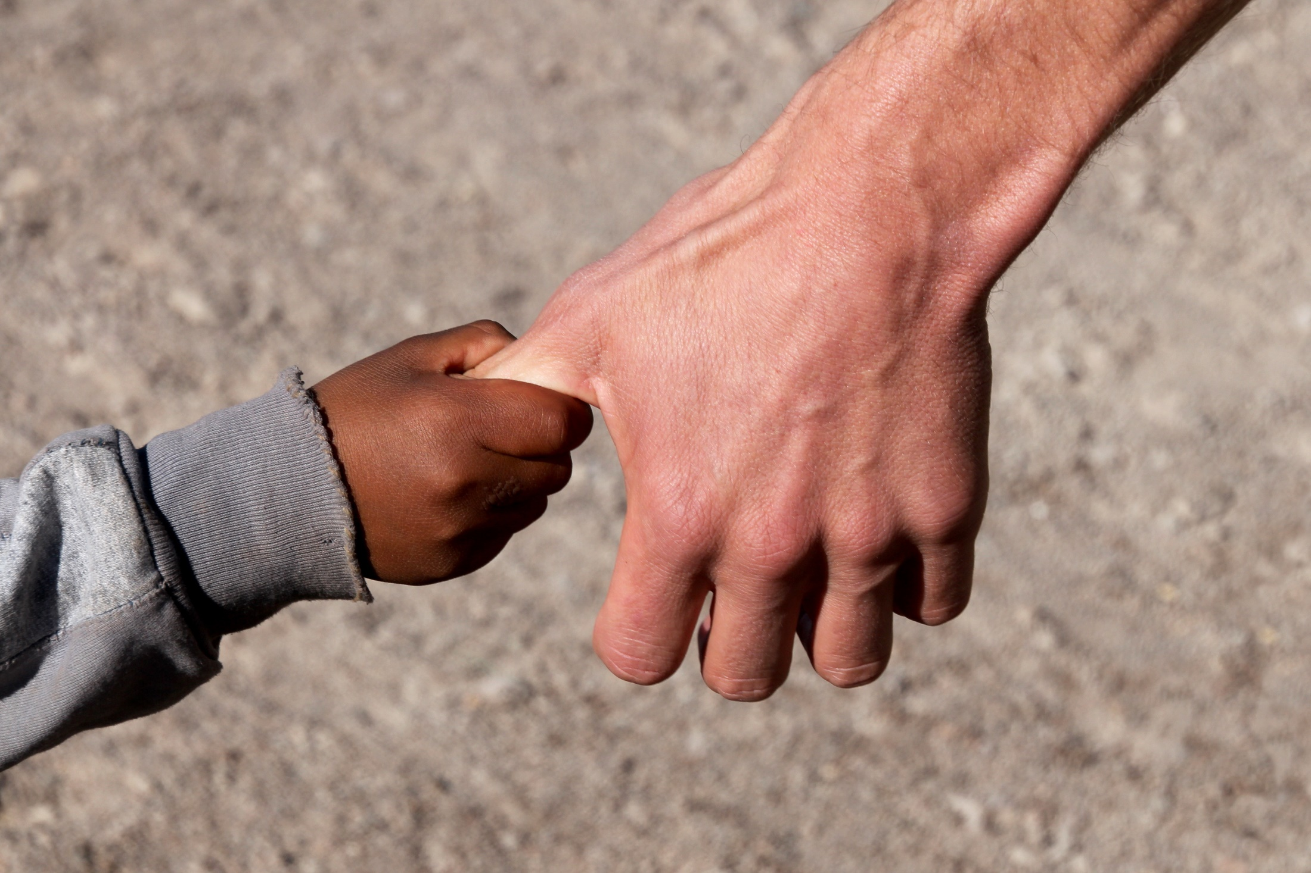
Boundless and Unfailing Love
© RioPatuca / Shutterstock.com

Slide 55
XIV
We adore you, O Christ, and praise you.
Because by your holy cross You have redeemed the world.

Slide 56
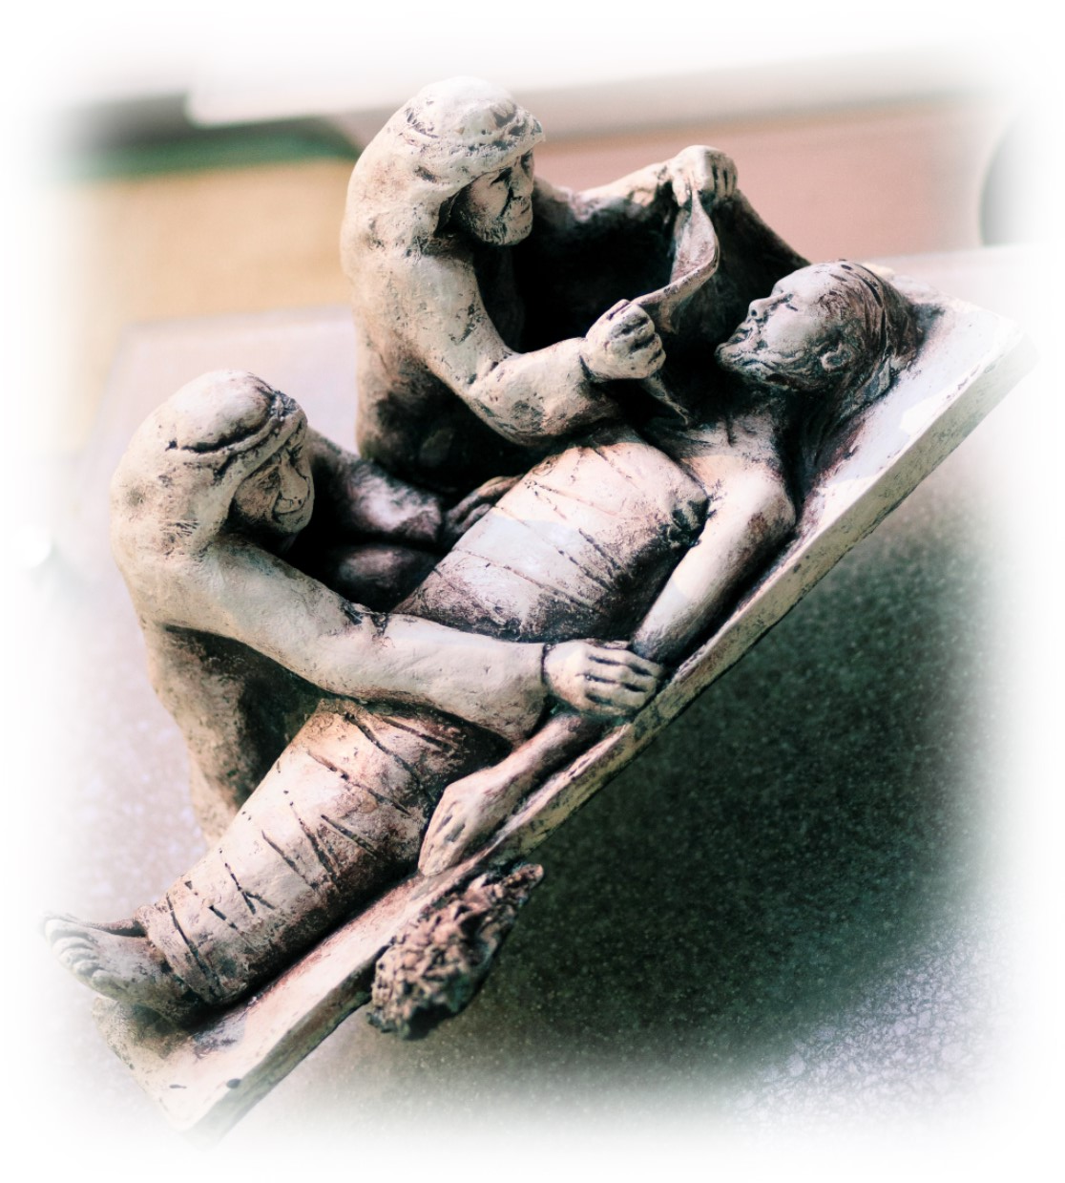
XIV
Jesus
is
Buried
© Catholic Archbishop of Perth

Slide 57
‘… he rolled a large stone across the entrance to the tomb …’ Matthew 27: 57-61, 65-66
Throw open the doors of darkness in our lives and let the light of Christ’s mercy shine in all we do.

Slide 58
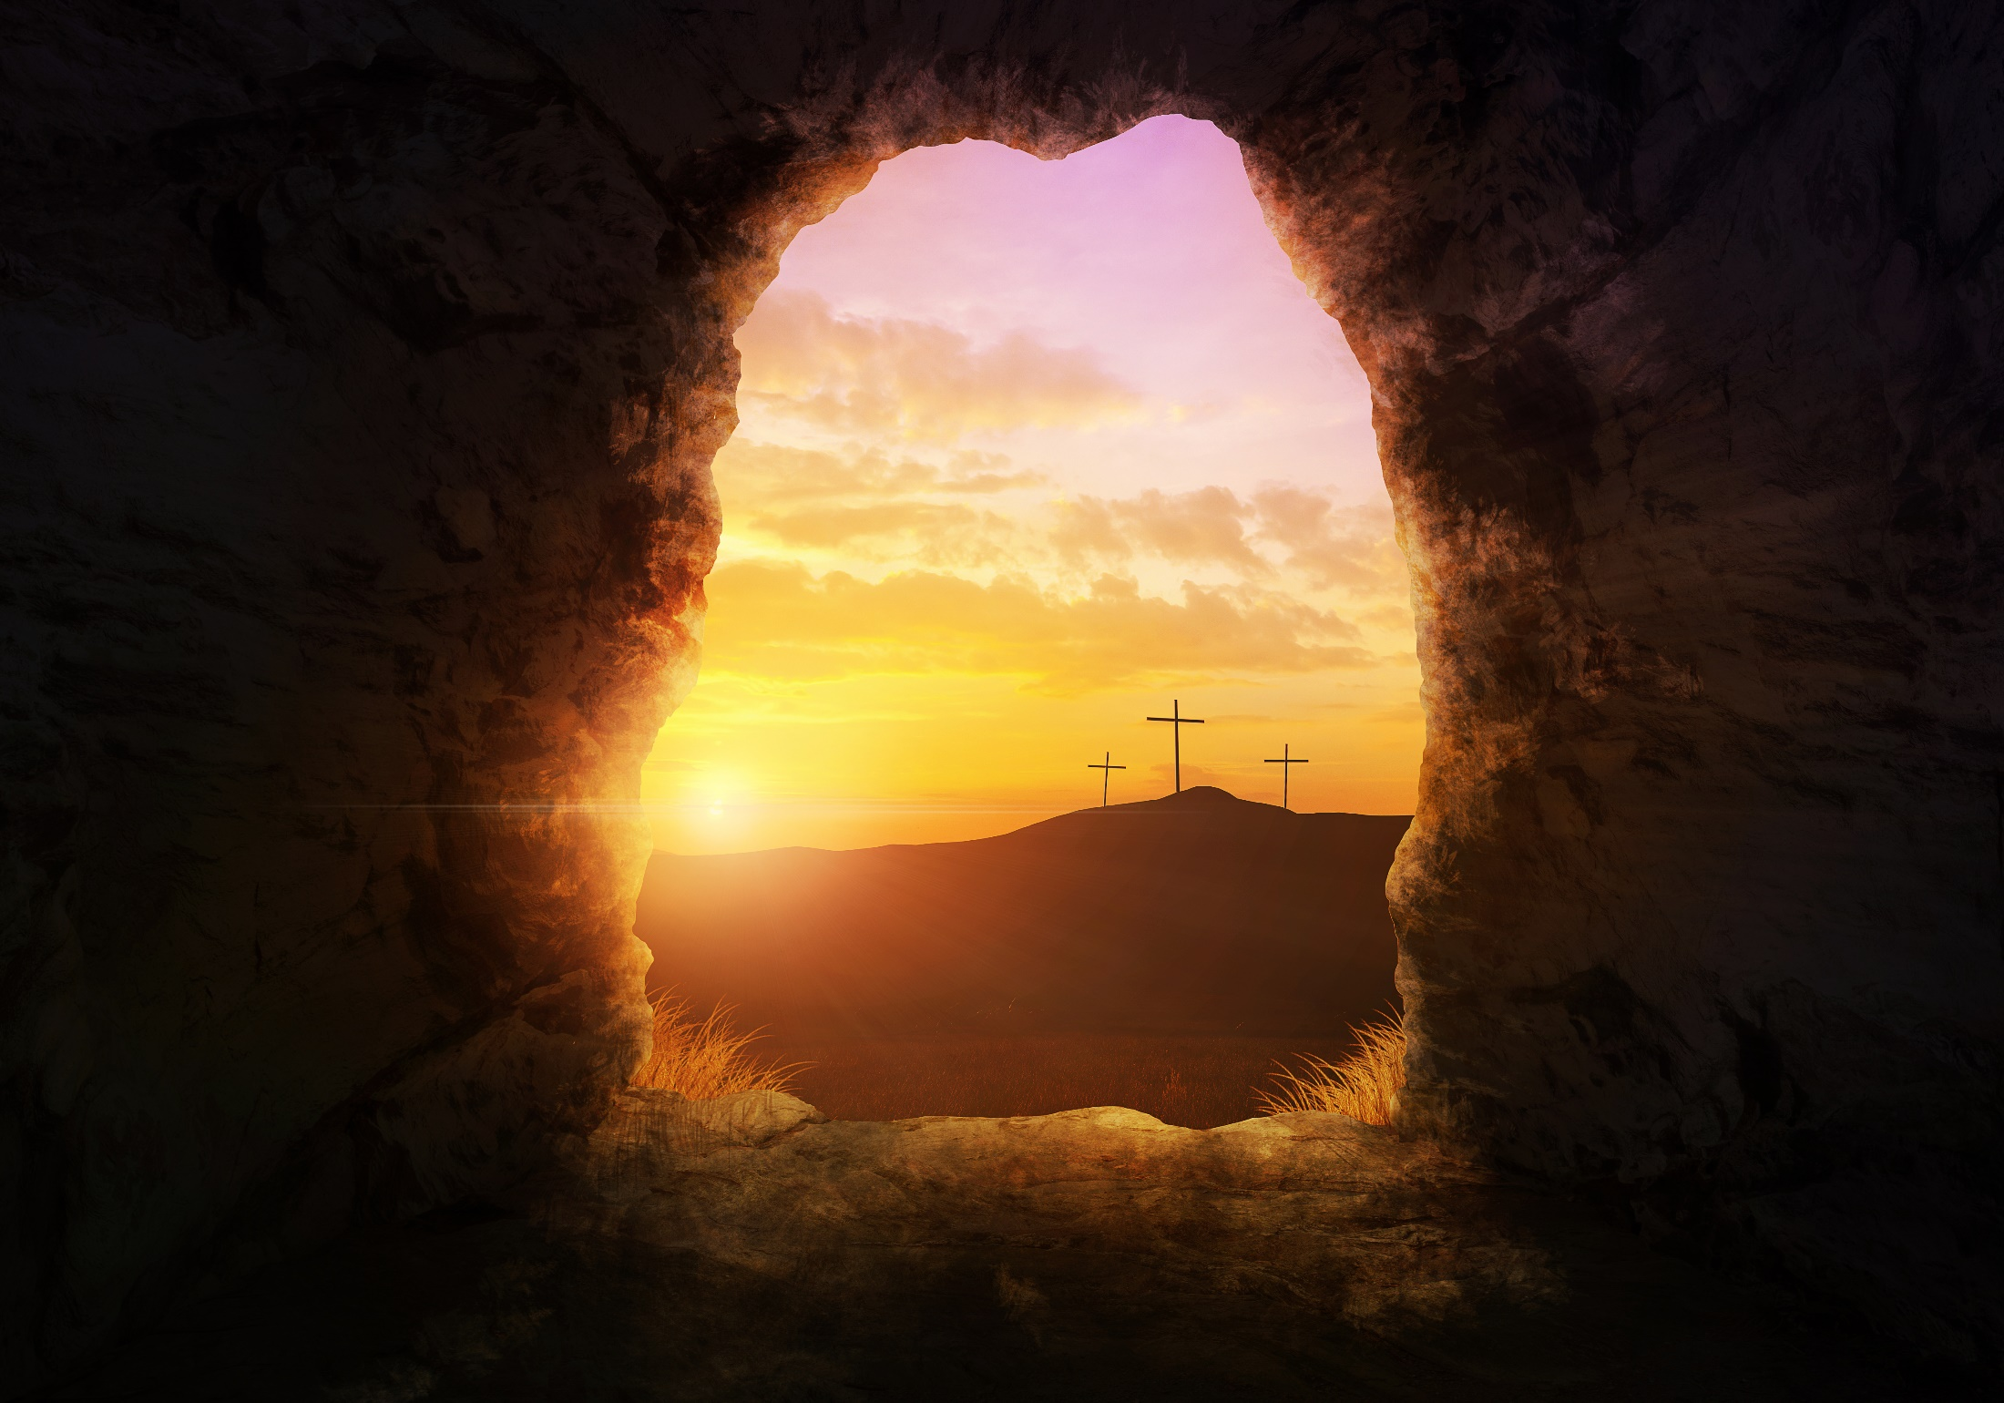
Take away the Stone of Shame
©Amanda Carden / Shutterstock.com

Slide 59
Pope Francis Final Reflection
What was a simple act of love-going to the tomb-has turned in to an event, a truly life-changing event. Nothing remains as it was before, not only in the lives of those (people), but also in our own lives and in the history of humankind. Jesus is not dead, he is alive. He does not simply return to life; rather he is life itself, because he is the Son of God, the living God. Jesus no longer belongs to the past, but lives in the present and is projected towards the future.

Slide 60
It is indeed my wish that the Jubilee be a living experience of the closeness of the Father, whose tenderness is almost tangible, so that the faith of every believer may be strengthened and thus testimony to it be ever more effective.
Pope Francis

Slide 61
COPYRIGHT NOTICE
Produced by Centre for Liturgy - Archdiocese of Perth. Western Australia
Scripture quotations are from the Good News Translation Revised Edition - © American Bible Society 1966, 1971, 1976, 1992.
All images are subject to copyright and may not be reproduced separately from this program.
The material in this program is subject to copyright. None of it may be reproduced in any other form for commercial purposes.
Background Music Peppers Theme Kevin MacLeod (incompetech.com) Licensed under Creative Commons: By Attribution 3.0 http://creativecommons.org/licenses/by/3.0/

