Slide 1
XVI General Ordinary
Assembly of the Synod of Bishops
Meditations by Card. Mario Grech
on the Joyful Mysteries of the Rosary

Slide 2
The Annunciation
of the Angel to Mary

Slide 3
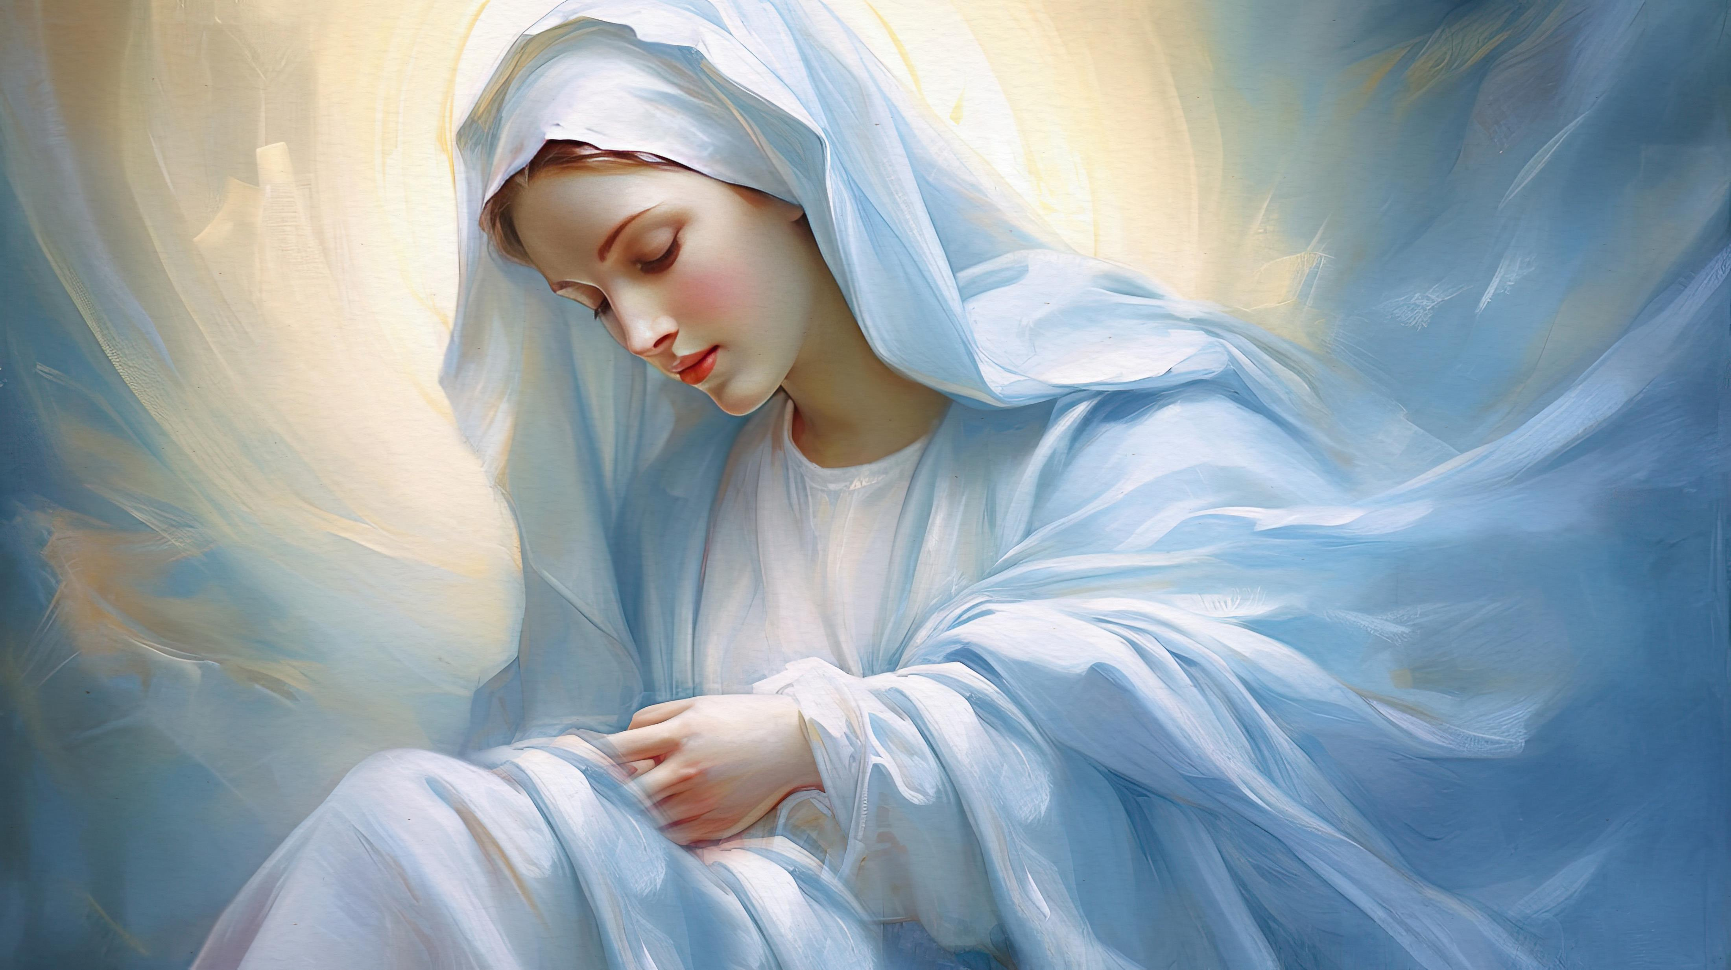
Renew our “Yes” to God

Slide 4
Mary’s visit to Elizabeth

Slide 5
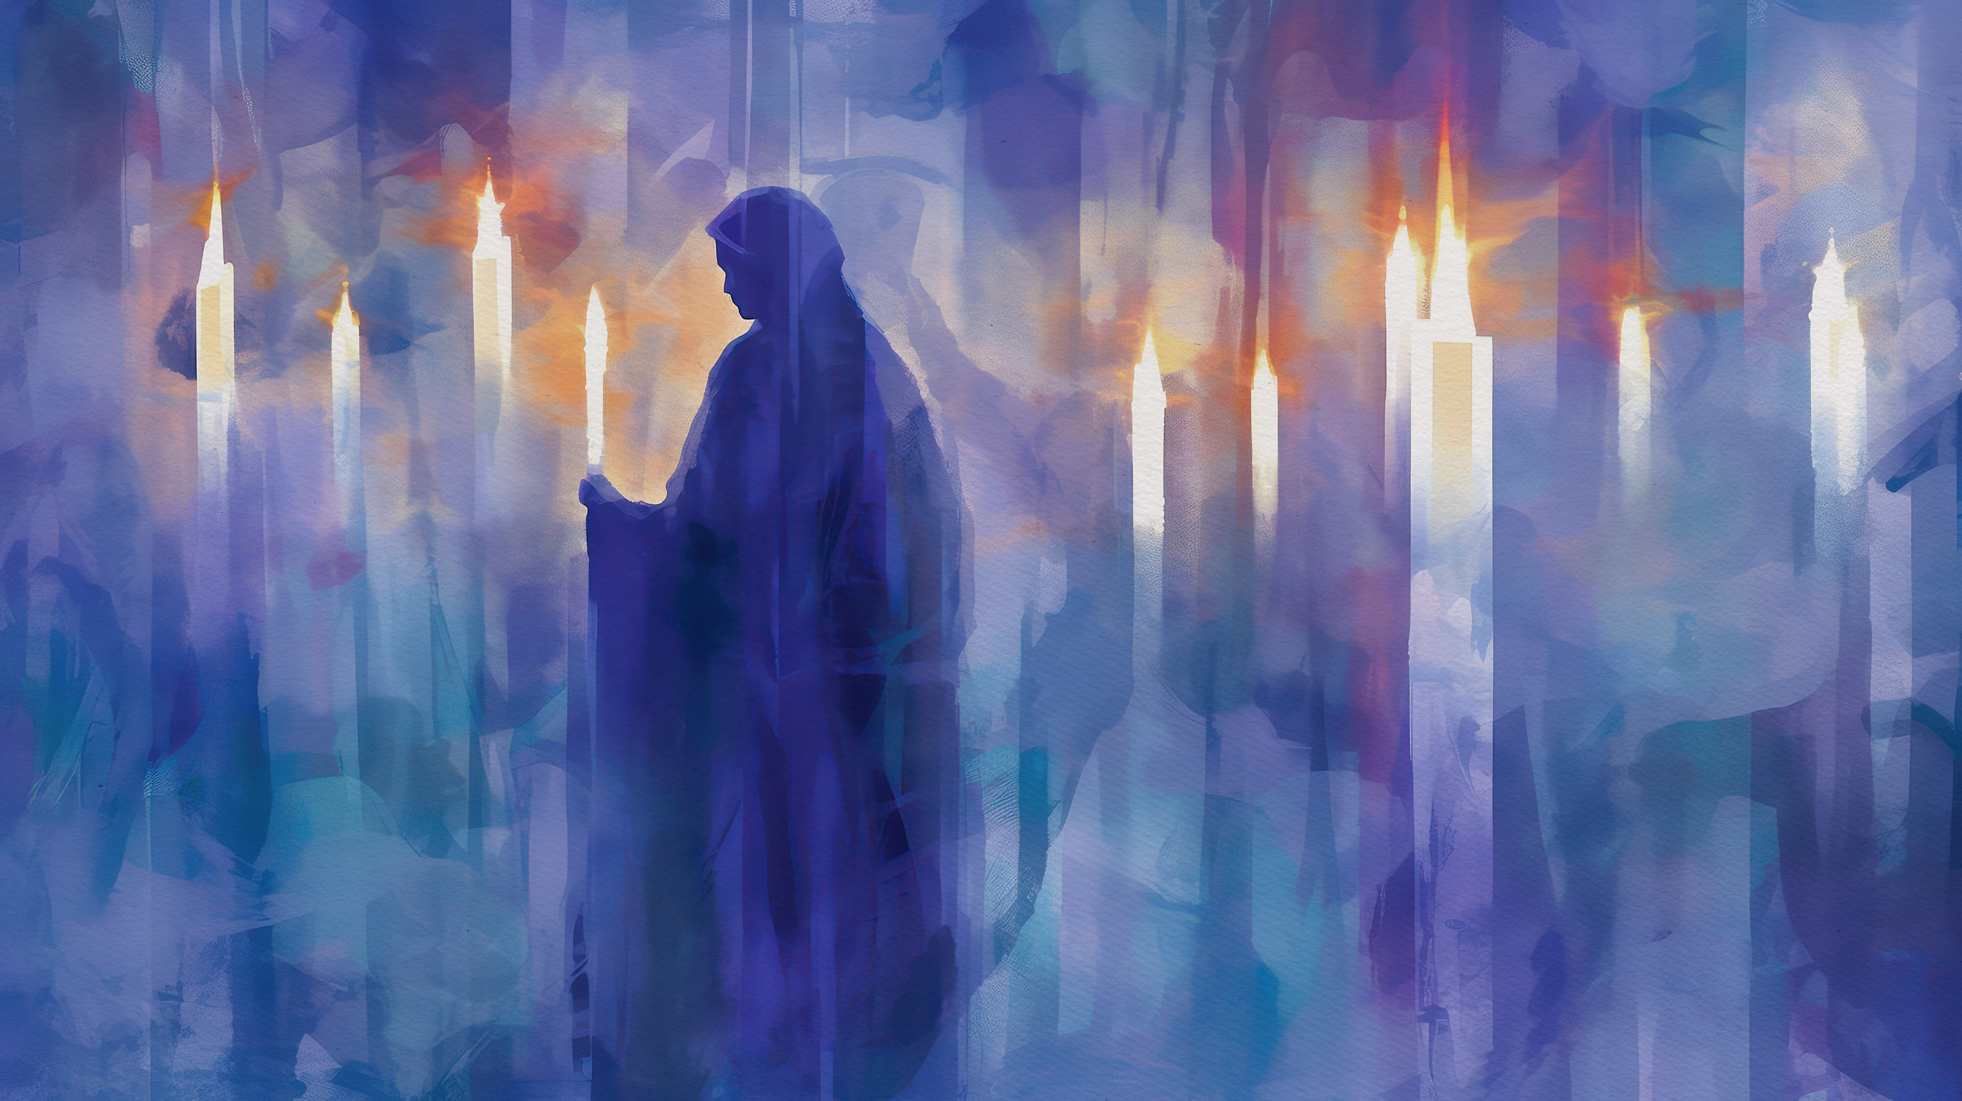
Our Missionary Journey

Slide 6
The birth of Jesus in Bethlehem

Slide 7
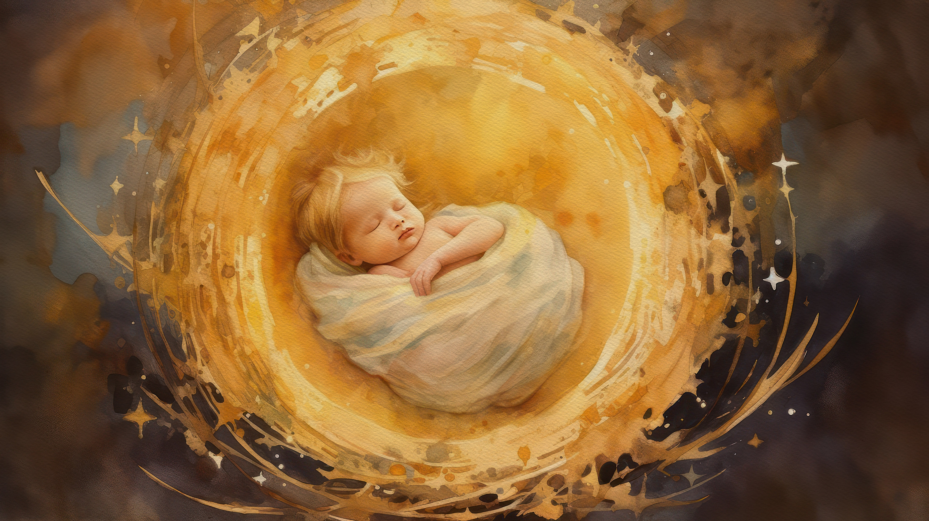
Our Common Mission

Slide 8
The presentation of Jesus
in the Temple

Slide 9
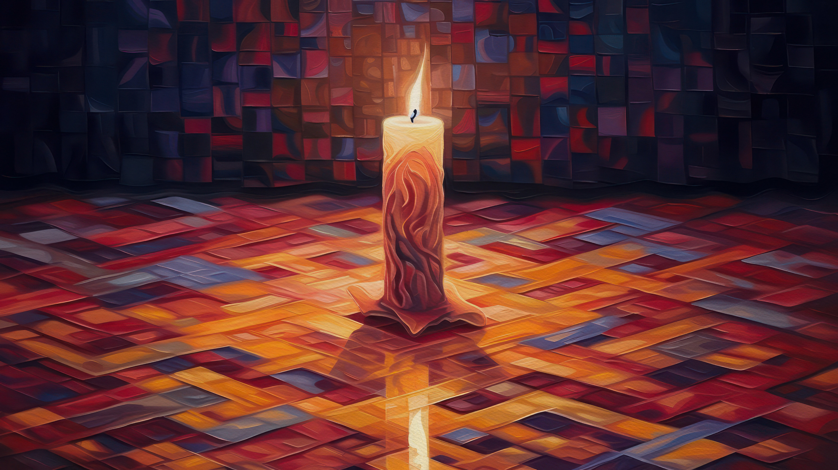
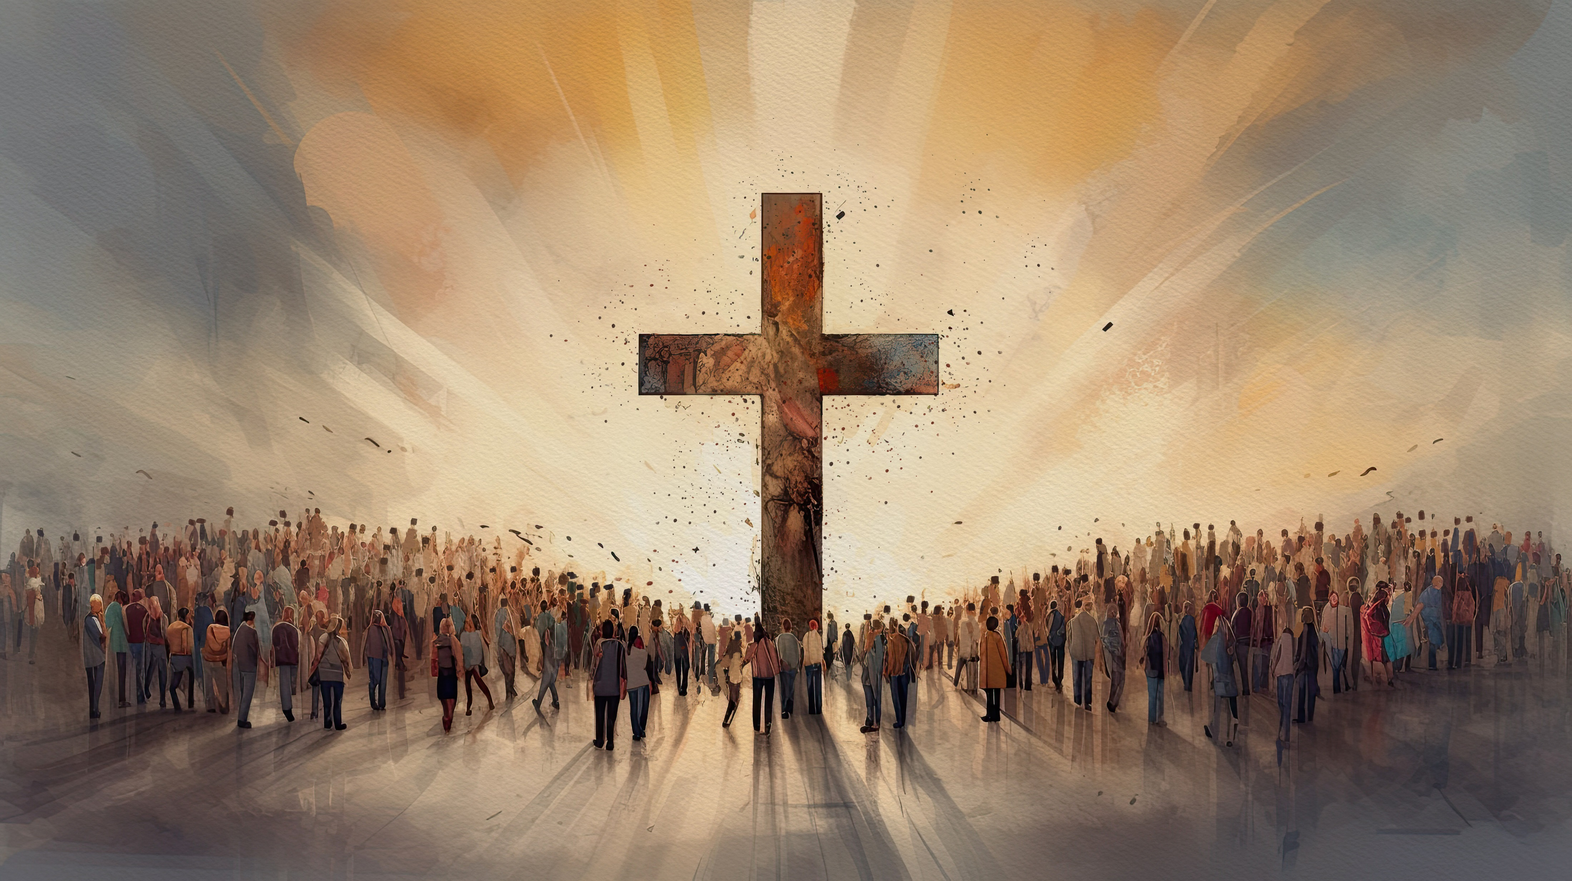
Incarnation and the Cross

Slide 10
Finding Jesus in the Temple

Slide 11
God’s will for His Church

